Slide 1
Measles and Rubella
Global Update
June 2025

Slide 2
Distribution list
This report is posted on the WHO Immunization data portal (https://immunizationdata.who.int/global?topic=Provisional-measles-and-rubella-data&location=) and distributed by email on a monthly basis.
To join the distribution list, please send an email to Sebastien Antoni (antonis@who.int)

Slide 3
Disclaimer
Please note that all data contained within is provisional. The number of cases of measles and rubella officially reported by a member state is only available by July of each year (through the joint WHO UNICEF annual data collection exercise). If any numbers from this provisional data are quoted, they should be properly sourced with a date (i.e. "provisional data based on monthly data reported to WHO (Geneva) as of June 2025"). For official data from 1980-2024, please visit our website.

Slide 4
Data sources and limitations

Slide 5
Measles

Slide 6
Number of reported measles cases by WHO Region
2025
Region | Member States* | Suspected MR cases | Measles cases | Clin | Epi | Lab | Date Received
AFR | 41/47 | 37,414 | 18,832 | 3,812 | 6,946 | 8,074 | 2025-06
AMR | 28/35 | 12,347 | 5,340 | 1 | 1,092 | 4,247 | 2025-06
EMR | 20/21 | 47,240 | 31,052 | 15,608 | 2,377 | 13,067 | 2025-06
EUR | 46/53 | 25,311 | 18,551 | 3,435 | 3,998 | 11,118 | 2025-06
SEAR | 11/11 | 48,529 | 10,856 | 4,670 | 1,785 | 4,401 | 2025-06
WPR | 22/27 | 17,514 | 4,222 | 981 | 93 | 3,148 | 2025-06
Total | 168/194 | 188,355 | 88,853 | 28,507 | 16,291 | 44,055
Region | Jan | Feb | Mar | Apr | May | Jun | Jul | Aug | Sep | Oct | Nov | Dec
AFR | 4,575 | 4,919 | 5,137 | 3,365 | 836 | 0 | 0 | 0 | 0 | 0 | 0 | 0
AMR | 73 | 407 | 1,188 | 2,226 | 1,409 | 37 | 0 | 0 | 0 | 0 | 0 | 0
EMR | 6,658 | 7,177 | 8,013 | 7,101 | 1,795 | 308 | 0 | 0 | 0 | 0 | 0 | 0
EUR | 4,890 | 4,432 | 4,567 | 4,464 | 198 | 0 | 0 | 0 | 0 | 0 | 0 | 0
SEAR | 2,331 | 2,451 | 2,585 | 2,401 | 1,088 | 0 | 0 | 0 | 0 | 0 | 0 | 0
WPR | 1,244 | 1,511 | 995 | 472 | 0 | 0 | 0 | 0 | 0 | 0 | 0 | 0
Total | 19,771 | 20,897 | 22,485 | 20,029 | 5,326 | 345 | 0 | 0 | 0 | 0 | 0 | 0
2024
Region | Member States* | Suspected MR cases | Measles cases | Clin | Epi | Lab | Date Received
AFR | 43/47 | 153,308 | 86,127 | 15,884 | 51,811 | 18,432 | 2025-06
AMR | 33/35 | 18,751 | 461 | 0 | 53 | 408 | 2025-06
EMR | 20/21 | 161,413 | 96,624 | 52,179 | 6,207 | 38,238 | 2025-06
EUR | 52/53 | 149,054 | 127,424 | 21,823 | 20,134 | 85,467 | 2025-06
SEAR | 11/11 | 157,049 | 36,887 | 12,303 | 6,952 | 17,632 | 2025-06
WPR | 25/27 | 67,848 | 12,011 | 3,774 | 673 | 7,564 | 2025-06
Total | 184/194 | 707,423 | 359,534 | 105,963 | 85,830 | 167,741
Region | Jan | Feb | Mar | Apr | May | Jun | Jul | Aug | Sep | Oct | Nov | Dec
AFR | 13,630 | 15,801 | 19,233 | 11,624 | 7,782 | 4,419 | 2,969 | 2,331 | 2,501 | 2,270 | 2,207 | 1,360
AMR | 23 | 49 | 103 | 47 | 18 | 19 | 41 | 38 | 37 | 33 | 44 | 9
EMR | 13,496 | 15,461 | 15,726 | 10,905 | 10,912 | 7,071 | 5,075 | 3,559 | 3,838 | 3,690 | 3,269 | 3,622
EUR | 29,073 | 24,210 | 20,550 | 15,702 | 12,922 | 9,448 | 5,177 | 2,412 | 1,501 | 1,391 | 2,019 | 3,019
SEAR | 3,898 | 3,793 | 4,731 | 3,449 | 2,872 | 1,915 | 2,040 | 2,805 | 3,182 | 3,671 | 2,716 | 1,815
WPR | 1,013 | 1,051 | 1,235 | 1,170 | 981 | 641 | 731 | 760 | 756 | 959 | 1,340 | 1,374
Total | 61,133 | 60,365 | 61,578 | 42,897 | 35,487 | 23,513 | 16,033 | 11,905 | 11,815 | 12,014 | 11,595 | 11,199
Notes: Based on data received 2025-06 - This is surveillance data, hence for the last month, the data may be incomplete. * Member States Reporting / Total Member States in Region

Slide 7

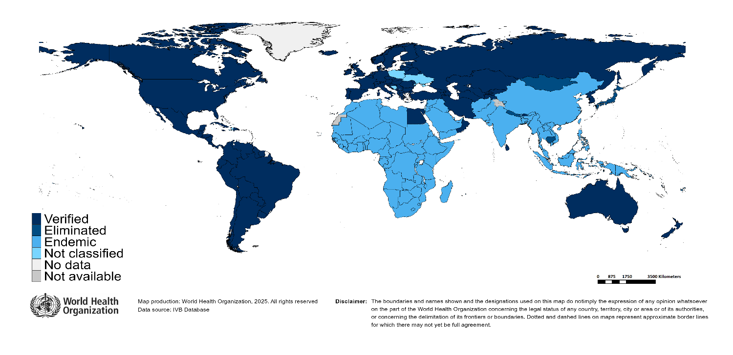
Measles/rubella verification of elimination
Measles
Region | Member States | Verified | % Verified | Eliminated | Endemic | Not classified
AFR | 47 | 0 | 0 | 0 | 47 | 0
AMR | 35 | 34 | 97 | 0 | 0 | 1
EMR | 21 | 4 | 19 | 0 | 17 | 0
EUR | 53 | 33 | 62 | 8 | 11 | 1
SEAR | 11 | 4 | 36 | 0 | 7 | 0
WPR | 27 | 6 | 22 | 15 | 6 | 0
GLOBAL | 194 | 81 | 42 | 23 | 88 | 2
Rubella
Region | Member States | Verified | % Verified | Eliminated | Endemic | Not classified
AFR | 47 | 0 | 0 | 0 | 47 | 0
AMR | 35 | 34 | 97 | 0 | 0 | 1
EMR | 21 | 4 | 19 | 0 | 17 | 0
EUR | 53 | 49 | 92 | 0 | 0 | 4
SEAR | 11 | 5 | 45 | 1 | 5 | 0
WPR | 27 | 5 | 19 | 16 | 6 | 0
GLOBAL | 194 | 97 | 50 | 17 | 75 | 5
Notes: Based on data available at WHO HQ as of 2025-06-10 . Terms used on this slide refer to the global framework for the verification of measles and rubella elimination. These terms might differ from those used by WHO Regional Offices. Verified = Elimination verified by Regional Verification Commitee (RVC); Eliminated = Eliminated transmission but no RVC verification yet.

Slide 8
Measles case distribution by month and WHO Region (2020-2025)
2020
2021
2022
2023
2024
2025
93,840 cases
59,619 cases
174,340 cases
321,889 cases
359,534 cases
88,853 cases
60,000
AFR
40,000
AMR
EMR
EUR
SEAR
WPR
20,000
0
Jan
Feb
Mar
Apr
May
Jun
Jul
Aug
Sep
Oct
Nov
Dec
Jan
Feb
Mar
Apr
May
Jun
Jul
Aug
Sep
Oct
Nov
Dec
Jan
Feb
Mar
Apr
May
Jun
Jul
Aug
Sep
Oct
Nov
Dec
Jan
Feb
Mar
Apr
May
Jun
Jul
Aug
Sep
Oct
Nov
Dec
Jan
Feb
Mar
Apr
May
Jun
Jul
Aug
Sep
Oct
Nov
Dec
Jan
Feb
Mar
Apr
May
Jun
Jul
Aug
Sep
Oct
Nov
Dec
Based on data received 2025-06 - Data Source: IVB Database - This is surveillance data, hence for the last month(s), the data may be incomplete.

Slide 9
Measles case distribution by month and WHO Region (2017-2025)
2017
2018
2019
2020
2021
2022
2023
2024
2025
168,190 cases
276,157 cases
541,401 cases
93,840 cases
59,619 cases
174,340 cases
321,889 cases
359,534 cases
88,853 cases
125,000
100,000
AFR
75,000
AMR
EMR
EUR
SEAR
50,000
WPR
25,000
0
May
Aug
Sep
May
Aug
Sep
May
Aug
Sep
May
Aug
Sep
May
Aug
Sep
May
Aug
Sep
May
Aug
Sep
May
Aug
Sep
May
Aug
Sep
Jan
Feb
Apr
Jun
Jul
Oct
Jan
Apr
Jun
Jul
Oct
Jan
Apr
Jun
Jul
Oct
Jan
Apr
Jun
Jul
Oct
Jan
Apr
Jun
Jul
Oct
Jan
Apr
Jun
Jul
Oct
Jan
Apr
Jun
Jul
Oct
Jan
Apr
Jun
Jul
Oct
Jan
Apr
Jun
Jul
Oct
Mar
Nov
Dec
Feb
Mar
Nov
Dec
Feb
Mar
Nov
Dec
Feb
Mar
Nov
Dec
Feb
Mar
Nov
Dec
Feb
Mar
Nov
Dec
Feb
Mar
Nov
Dec
Feb
Mar
Nov
Dec
Feb
Mar
Nov
Dec
Based on data received 2025-06 - Data Source: IVB Database - This is surveillance data, hence for the last month(s), the data may be incomplete.

Slide 10
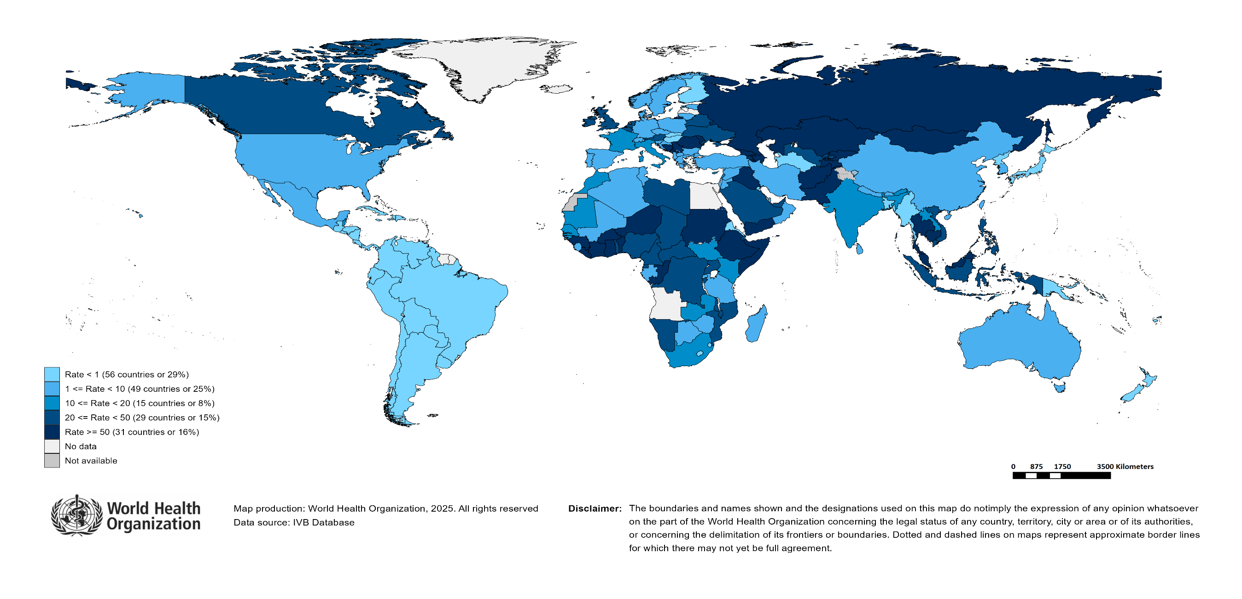
Measles Incidence Rate per Million (12M period)
Highest incidence rates | Highest incidence rates | Highest incidence rates
Country | Cases | Rate
Kyrgyzstan | 11035 | 1,535.62
Romania | 17580 | 924.53
Yemen | 26635 | 656.31
Afghanistan | 11682 | 273.92
Kazakhstan | 4946 | 240.18
Liberia | 914 | 162.84
Bosnia and Herzegovina | 510 | 161.18
Georgia | 607 | 159.42
Serbia | 979 | 145.33
Tajikistan | 1403 | 132.47
Notes: Based on data received 2025-06 - Surveillance data from 2024-05 to 2025-04 - Incidence: Number of cases / population * 1,000,000 - Population data: World population prospects, 2019 revision

Slide 11
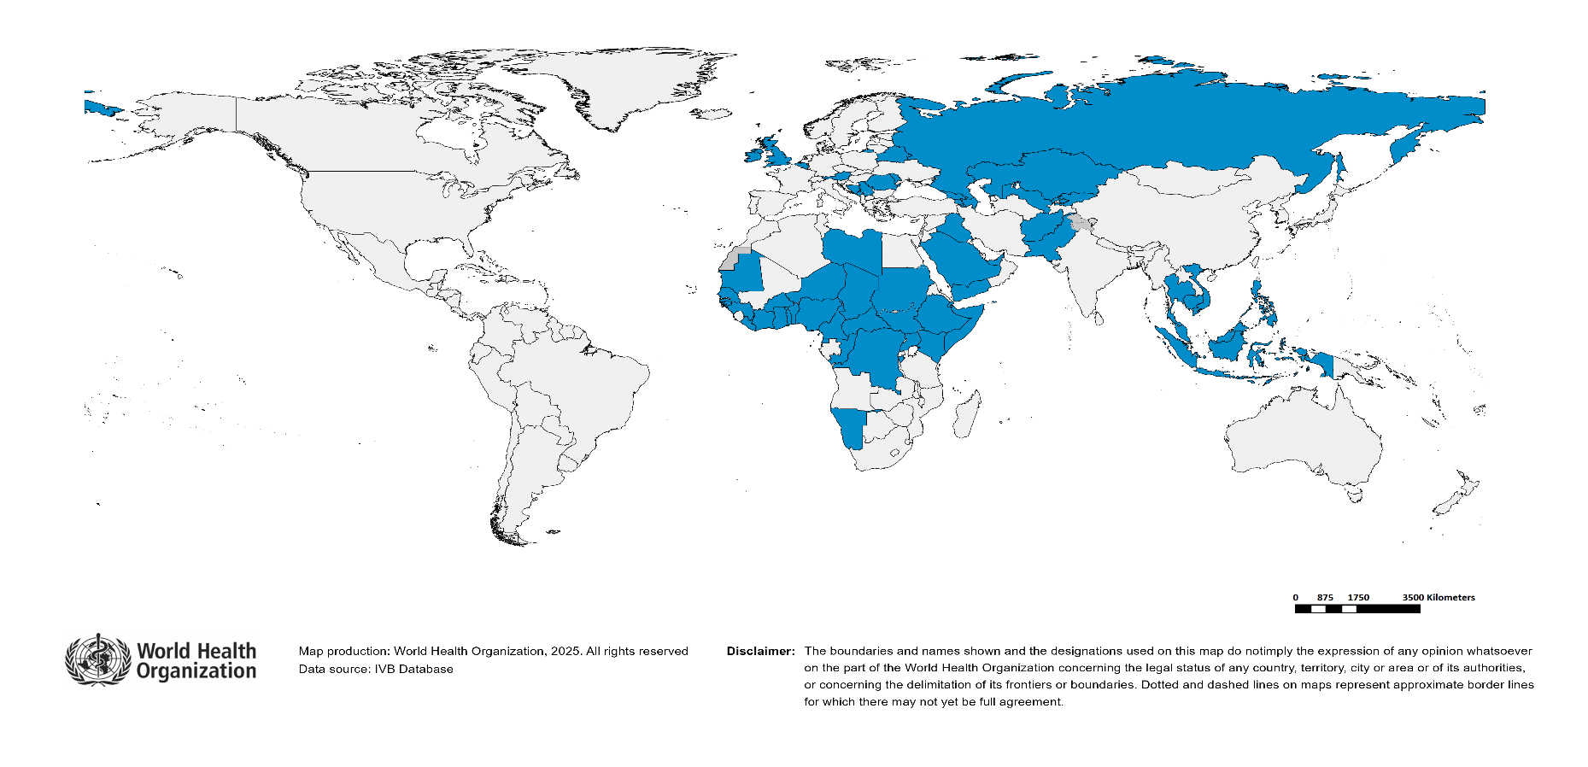
Immunization Agenda 2030 - Impact Goal 1.3
Countries provisionally meeting the large and disruptive outbreaks definition - Data from 2024-02 to 2025-01 included
Country | Cases | Rate/M | Clinical*
Kyrgyzstan | 13,651 | 1,871.27 | 45%
Romania | 27,993 | 1,480.43 | 3%
Kazakhstan | 18,805 | 902.19 | 3%
Azerbaijan | 8,586 | 825.76 | 75%
Yemen | 24,155 | 578.23 | 94%
Iraq | 25,256 | 537.12 | 85%
Bosnia and Herzegovina | 1,588 | 505.72 | 80%
Liberia | 2,040 | 355.95 | 11%
Burkina Faso | 6,769 | 281.17 | 76%
Equatorial Guinea | 474 | 244.53 | 60%
Afghanistan | 10,503 | 239.55 | 0%
South Sudan | 2,542 | 208.55 | 70%
Ethiopia | 25,462 | 187.95 | 0%
Côte d'Ivoire | 5,981 | 182.84 | 0%
Armenia | 501 | 169.69 | 0%
Burundi | 2,300 | 159.83 | 2%
Serbia | 954 | 142.62 | 35%
Russian Federation | 19,218 | 133.46 | 0%
Thailand | 8,318 | 116.14 | 35%
Ghana | 3,890 | 110.94 | 4%
Pakistan | 23,591 | 92.43 | 10%
Malaysia | 3,197 | 88.86 | 6%
Georgia | 333 | 87.48 | 7%
Republic of Moldova | 223 | 74.43 | 1%
Somalia | 1,454 | 73.98 | 0%
Niger | 1,950 | 69.85 | 32%
Montenegro | 40 | 63.22 | 0%
Austria | 545 | 59.80 | 0%
San Marino | 2 | 59.57 | 0%
Country | Cases | Rate/M | Clinical*
Benin | 880 | 59.40 | 21%
Cambodia | 989 | 55.41 | 0%
Monaco | 2 | 52.16 | 0%
Mauritania | 269 | 50.61 | 0%
Djibouti | 59 | 49.83 | 0%
Guinea | 742 | 49.14 | 13%
Chad | 989 | 47.09 | 7%
Belgium | 551 | 46.86 | 7%
United Arab Emirates | 516 | 45.48 | 10%
Belarus | 402 | 44.68 | 0%
Ireland | 236 | 44.46 | 1%
Togo | 428 | 44.03 | 11%
DR Congo | 4,704 | 41.69 | 2%
Nigeria | 9,443 | 39.76 | 59%
United Kingdom of Great Britain and Northern Ireland | 2,738 | 39.37 | 0%
Philippines | 4,064 | 34.80 | 83%
Uzbekistan | 1,264 | 34.11 | 2%
Saudi Arabia | 1,170 | 33.85 | 0%
Sudan | 1,557 | 30.14 | 5%
Cameroon | 877 | 29.35 | 12%
Namibia | 86 | 27.81 | 72%
Congo | 179 | 27.60 | 8%
Libya | 193 | 25.88 | 0%
Senegal | 480 | 25.35 | 8%
Guinea-Bissau | 56 | 24.89 | 100%
Indonesia | 6,964 | 24.37 | 56%
Kenya | 1,369 | 23.80 | 5%
Central African Republic | 125 | 22.67 | 4%
Viet Nam | 2,233 | 21.98 | 9%
Uganda | 1,064 | 20.71 | 6%
Total: 59 countries
In the frame of tracking progress towards the goals of Immunization Agenda 2030 (IA2030), an indicator has been developed by a working group in order to represent large and disruptive measles outbreaks. This indicator is defined as an incidence equal or greater than 20 reported measles cases per million population over a period of 12 months. It is important to note that measles outbreak definitions vary between countries and regions according to local context and level of progress towards regional elimination goals. This definition of large and disruptive outbreaks aims to complement and not replace the national and regional definitions, while also providing a degree of global standardization and permitting tracking of progress against a common metric.
Notes: Based on data received 2025-06 and covering the period between 2024-02 and 2025-01 - Incidence: Number of cases / 1M population - Population Data: World population prospects, 2019 revision - A high proportion of clinical cases indicates a high level of uncertainty associated with the incidence rates and the inclusion of countries in this list.

Slide 12
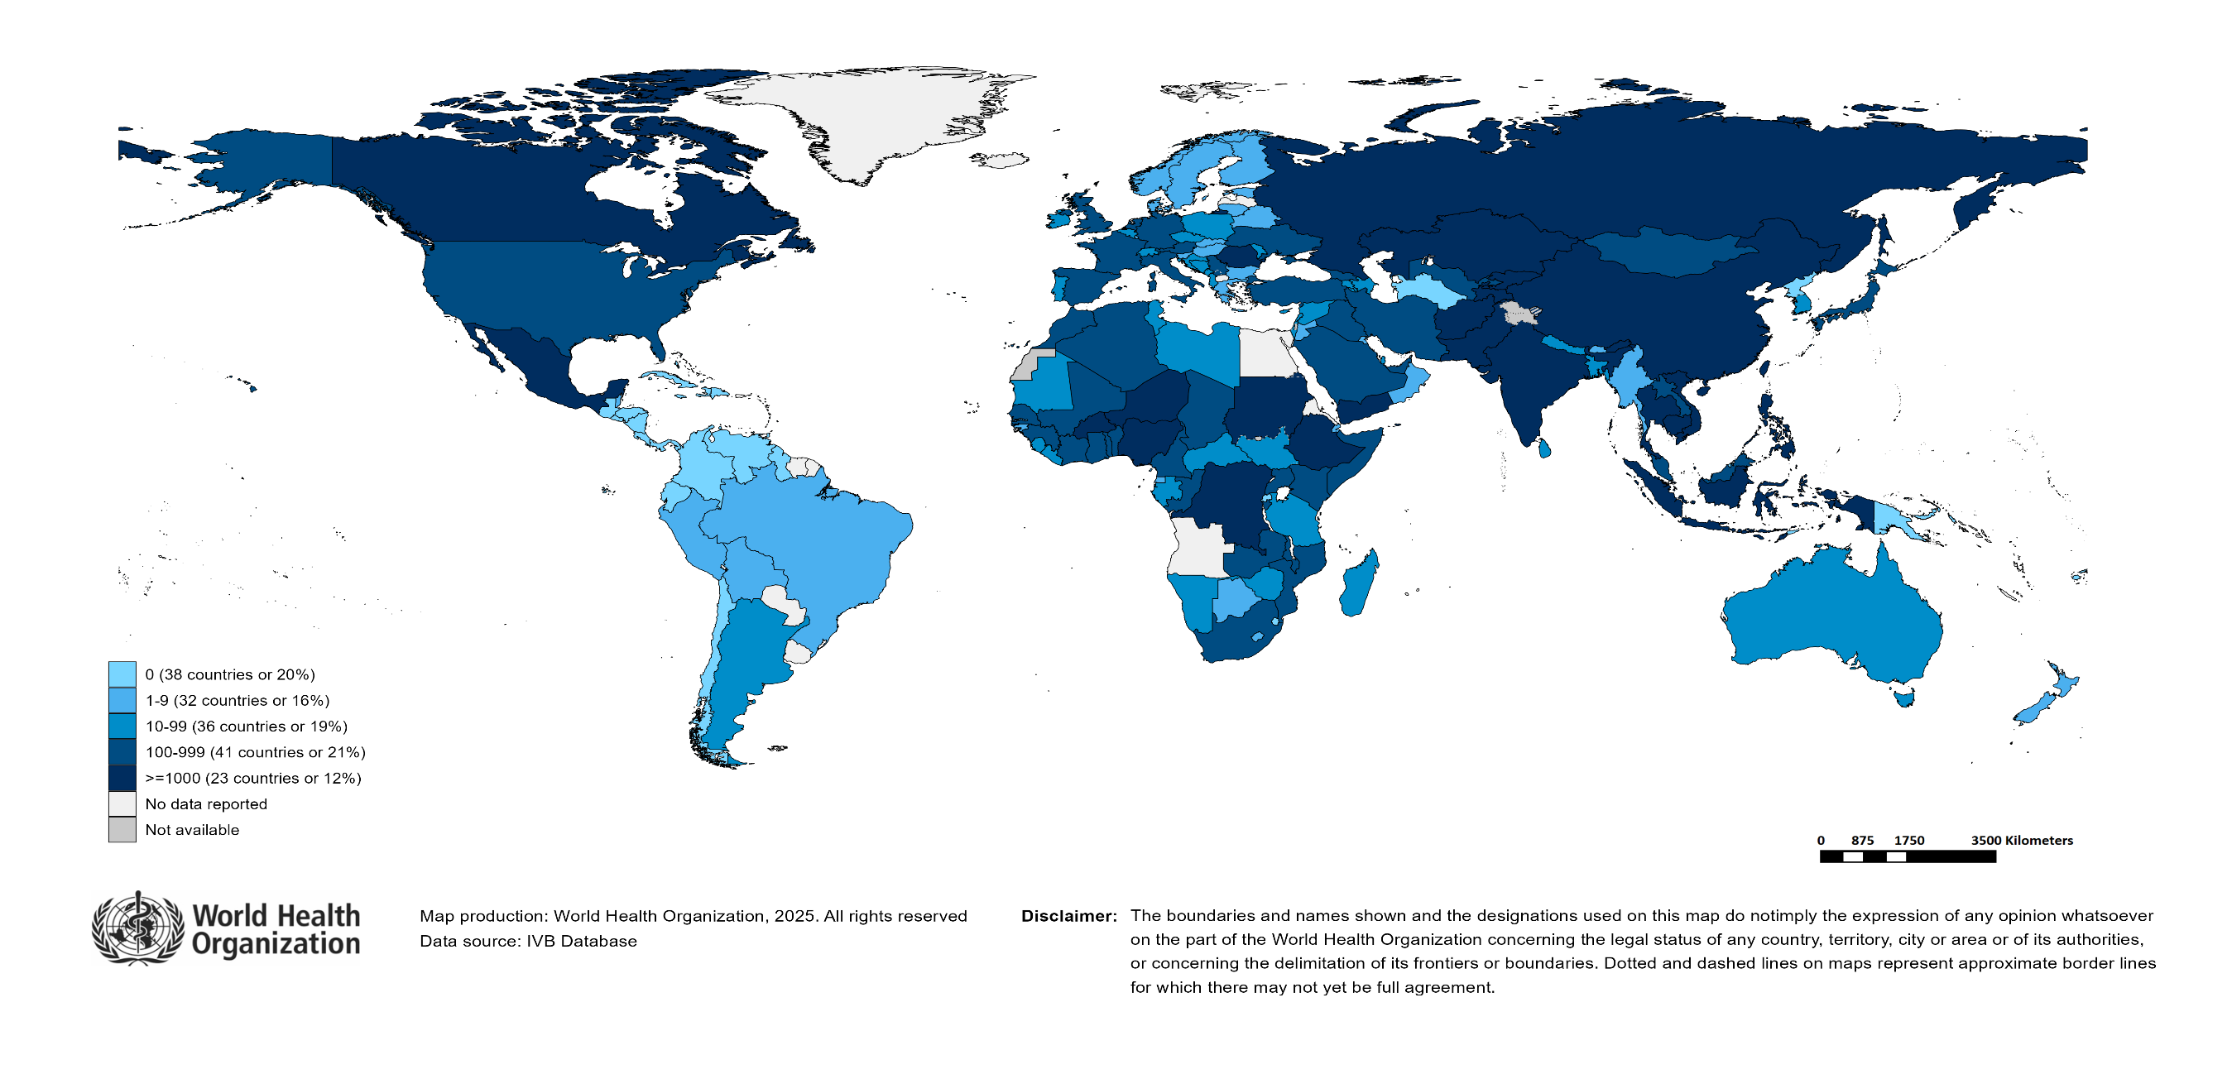
Number of Reported Measles Cases (Last 6 months)
Country | Cases*
Yemen | 15,344
India** | 9,677
Pakistan | 8,946
Kyrgyzstan | 7,307
Afghanistan | 7,252
Ethiopia | 6,184
Romania | 5,414
Nigeria | 2,730
Indonesia | 2,569
Russian Federation | 2,226
Notes: Based on data received 2025-06 - Surveillance data from 2024-11 to 2025-04 - * Countries with highest number of cases for the period - **WHO classifies all suspected measles cases reported from India as measles clinically compatible if a specimen was not collected as per the algorithm for classification of suspected measles in the WHO VPD Surveillance Standards. Thus numbers might be different between what WHO reports and what India reports.

Slide 13
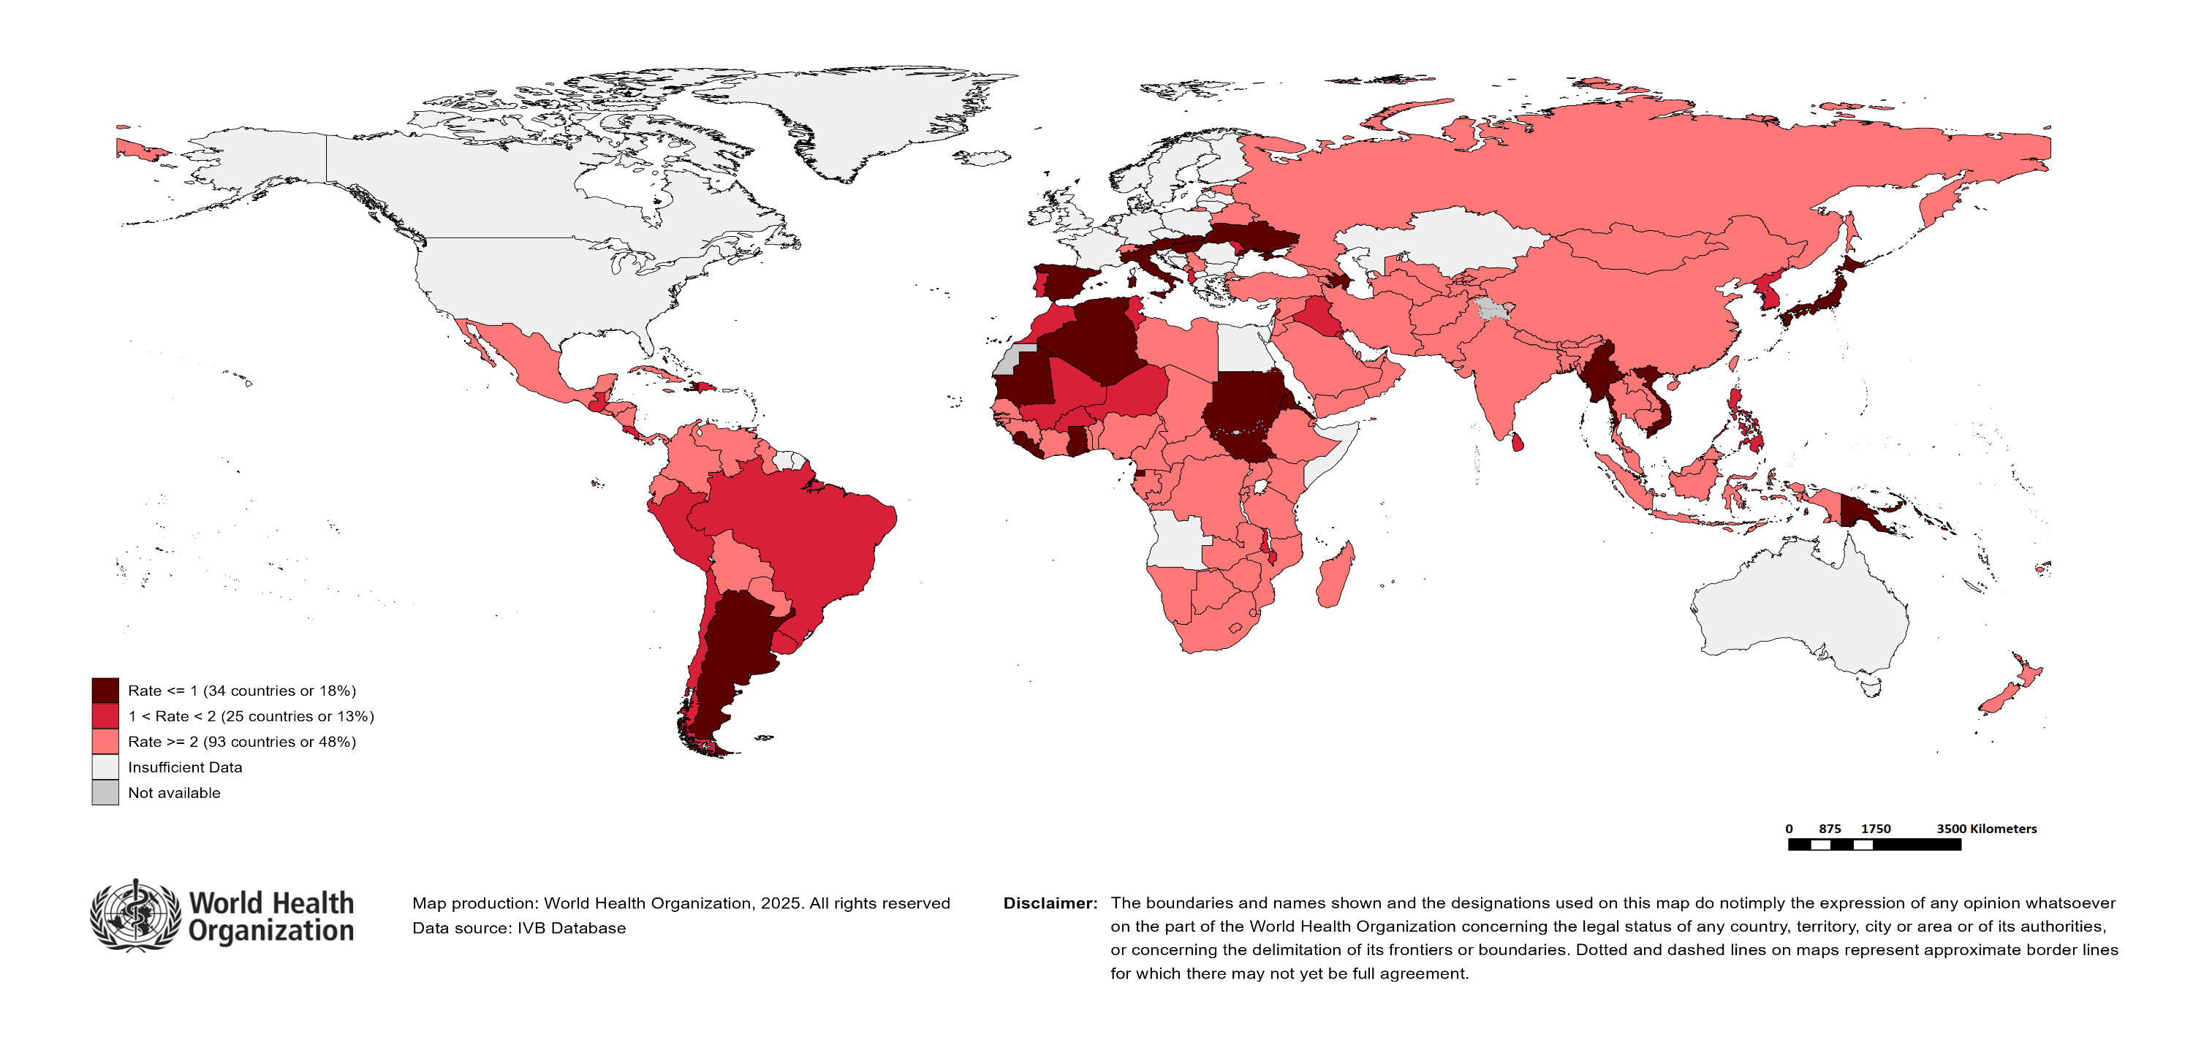
Surveillance sensitivity reporting rate of measles and rubella (12 months, discarded cases* per 100,000 population)
Notes: Based on data received 2025-06 - Surveillance data from 2024-05 to 2025-04 - Target: >= 2 discarded cases* / 100,000 population** - * Suspected cases investigated and discarded as non-measles non-rubella using laboratory testing and/or epidemiological linkage to another etiology ** World population prospects, 2019 revision

Slide 14
Disclaimer
This document contains data provided to WHO by member states. Note that some member states only provide aggregate data to WHO, and for these, we are unable to generate a country profile. Some member states report all cases at one time point for the entire year, and thus epidemiologic curves generated are not accurate and a reporting artifact. For some countries, cases are reported by age category, not by exact age in months and/or years. Thus, age distribution/incidence is approximate. Cases classified as pending by countries are classified at WHO as clinically compatible at this time, and thus numbers might different between data shown here and provided by the member state or WHO country/regional offices.
*UN population data is used as the denominator for calculating incidence.

Slide 15
Measles case distribution (AFR), 2020-2025
2020
2021
2022
2023
2024
2025
20,000
46,747 cases
26,492 cases
64,922 cases
73,443 cases
86,127 cases
18,832 cases
15,000
10,000
5,000
0
Jan
Feb
Mar
Apr
May
Jun
Jul
Aug
Sep
Oct
Nov
Dec
Jan
Feb
Mar
Apr
May
Jun
Jul
Aug
Sep
Oct
Nov
Dec
Jan
Feb
Mar
Apr
May
Jun
Jul
Aug
Sep
Oct
Nov
Dec
Jan
Feb
Mar
Apr
May
Jun
Jul
Aug
Sep
Oct
Nov
Dec
Jan
Feb
Mar
Apr
May
Jun
Jul
Aug
Sep
Oct
Nov
Dec
Jan
Feb
Mar
Apr
May
Jun
Jul
Aug
Sep
Oct
Nov
Dec
Cameroon
DR Congo
Ethiopia
Liberia
Nigeria
Others
Based on data received 2025-06 - Data Source: IVB Database

Slide 16
Measles cases: Congo
ELIMINATION STATUS:
ENDEMIC
2021
2022
2023
2024
2025
173 case(s)
340 case(s)
392 case(s)
182 case(s)
358 case(s)
SIA
150
Discarded
Clinical
Epi
100
Number of measles cases
Lab
50
0
Jan
Feb
Mar
Apr
May
Jun
Jul
Aug
Sep
Oct
Nov
Dec
Jan
Feb
Mar
Apr
May
Jun
Jul
Aug
Sep
Oct
Nov
Dec
Jan
Feb
Mar
Apr
May
Jun
Jul
Aug
Sep
Oct
Nov
Dec
Jan
Feb
Mar
Apr
May
Jun
Jul
Aug
Sep
Oct
Nov
Dec
Jan
Feb
Mar
Apr
May
Jun
Jul
Aug
Sep
Oct
Nov
Dec
Age distribution, vaccination status and incidence (last 12 months)
WHO/UNICEF Coverage Estimates (WUENIC)
200
1200
100
150
80
800
Number of cases
Incidence rate per M
60
100
% Coverage
50
400
40
0
0
20
<1 yr
1-4 yrs
5-9 yrs
10-14 yrs
15-24 yrs
25-39 yrs
40+ yrs
0
Age at onset (in years)
2000
2001
2002
2003
2004
2005
2006
2007
2008
2009
2010
2011
2012
2013
2014
2015
2016
2017
2018
2019
2020
2021
2022
2023
Incidence
2+ doses
1 dose
0 doses
Unknown
MCV1
MCV2
Based on data received 2025-06 - Data Source: IVB Database. Main epi curve was built using case-based surveillance data. Age distribution curve was built using case-based surveillance data. Coverage data from WHO/UNICEF Estimates of National Immunization Coverage (WUENIC)

Slide 17
Measles cases: Democratic Republic of the Congo
ELIMINATION STATUS:
ENDEMIC
2021
2022
2023
2024
2025
3,000
3,443 case(s)
4,365 case(s)
10,701 case(s)
5,086 case(s)
1,523 case(s)
SIA
Discarded
2,000
Clinical
Epi
Number of measles cases
Lab
1,000
0
Jan
Feb
Mar
Apr
May
Jun
Jul
Aug
Sep
Oct
Nov
Dec
Jan
Feb
Mar
Apr
May
Jun
Jul
Aug
Sep
Oct
Nov
Dec
Jan
Feb
Mar
Apr
May
Jun
Jul
Aug
Sep
Oct
Nov
Dec
Jan
Feb
Mar
Apr
May
Jun
Jul
Aug
Sep
Oct
Nov
Dec
Jan
Feb
Mar
Apr
May
Jun
Jul
Aug
Sep
Oct
Nov
Dec
Age distribution, vaccination status and incidence (last 12 months)
WHO/UNICEF Coverage Estimates (WUENIC)
2,000
150
100
1,500
100
80
Number of cases
1,000
Incidence rate per M
60
50
% Coverage
500
40
0
0
20
<1 yr
1-4 yrs
5-9 yrs
10-14 yrs
15-24 yrs
25-39 yrs
40+ yrs
0
Age at onset (in years)
2000
2001
2002
2003
2004
2005
2006
2007
2008
2009
2010
2011
2012
2013
2014
2015
2016
2017
2018
2019
2020
2021
2022
2023
Incidence
2+ doses
1 dose
0 doses
Unknown
MCV1
MCV2
Based on data received 2025-06 - Data Source: IVB Database. Main epi curve was built using case-based surveillance data. Age distribution curve was built using case-based surveillance data. Coverage data from WHO/UNICEF Estimates of National Immunization Coverage (WUENIC)

Slide 18
Measles cases: Ethiopia
ELIMINATION STATUS:
ENDEMIC
2021
2022
2023
2024
2025
1,947 case(s)
8,216 case(s)
16,505 case(s)
30,201 case(s)
4,781 case(s)
SIA
8,000
Discarded
6,000
Clinical
Epi
Number of measles cases
Lab
4,000
2,000
0
Jan
Feb
Mar
Apr
May
Jun
Jul
Aug
Sep
Oct
Nov
Dec
Jan
Feb
Mar
Apr
May
Jun
Jul
Aug
Sep
Oct
Nov
Dec
Jan
Feb
Mar
Apr
May
Jun
Jul
Aug
Sep
Oct
Nov
Dec
Jan
Feb
Mar
Apr
May
Jun
Jul
Aug
Sep
Oct
Nov
Dec
Jan
Feb
Mar
Apr
May
Jun
Jul
Aug
Sep
Oct
Nov
Dec
Age distribution, vaccination status and incidence (last 12 months)
WHO/UNICEF Coverage Estimates (WUENIC)
400
100
4,000
300
80
Incidence rate per M
60
Number of cases
200
% Coverage
2,000
40
100
0
0
20
<1 yr
1-4 yrs
5-9 yrs
10-14 yrs
15-24 yrs
25-39 yrs
40+ yrs
0
Age at onset (in years)
2000
2001
2002
2003
2004
2005
2006
2007
2008
2009
2010
2011
2012
2013
2014
2015
2016
2017
2018
2019
2020
2021
2022
2023
Incidence
2+ doses
1 dose
0 doses
Unknown
MCV1
MCV2
Based on data received 2025-06 - Data Source: IVB Database. Main epi curve was built using case-based surveillance data. Age distribution curve was built using case-based surveillance data. Coverage data from WHO/UNICEF Estimates of National Immunization Coverage (WUENIC)

Slide 19
Measles cases: Malawi
ELIMINATION STATUS:
ENDEMIC
2021
2022
2023
2024
2025
43 case(s)
32 case(s)
161 case(s)
180 case(s)
771 case(s)
SIA
300
Discarded
Clinical
200
Epi
Number of measles cases
Lab
100
0
Jan
Feb
Mar
Apr
May
Jun
Jul
Aug
Sep
Oct
Nov
Dec
Jan
Feb
Mar
Apr
May
Jun
Jul
Aug
Sep
Oct
Nov
Dec
Jan
Feb
Mar
Apr
May
Jun
Jul
Aug
Sep
Oct
Nov
Dec
Jan
Feb
Mar
Apr
May
Jun
Jul
Aug
Sep
Oct
Nov
Dec
Jan
Feb
Mar
Apr
May
Jun
Jul
Aug
Sep
Oct
Nov
Dec
Age distribution, vaccination status and incidence (last 12 months)
WHO/UNICEF Coverage Estimates (WUENIC)
150
100
60
80
100
40
Number of cases
Incidence rate per M
60
50
% Coverage
20
40
0
0
20
<1 yr
1-4 yrs
5-9 yrs
10-14 yrs
15-24 yrs
25-39 yrs
40+ yrs
0
Age at onset (in years)
2000
2001
2002
2003
2004
2005
2006
2007
2008
2009
2010
2011
2012
2013
2014
2015
2016
2017
2018
2019
2020
2021
2022
2023
Incidence
2+ doses
1 dose
0 doses
Unknown
MCV1
MCV2
Based on data received 2025-06 - Data Source: IVB Database. Main epi curve was built using case-based surveillance data. Age distribution curve was built using case-based surveillance data. Coverage data from WHO/UNICEF Estimates of National Immunization Coverage (WUENIC)

Slide 20
Measles cases: Niger
ELIMINATION STATUS:
ENDEMIC
2021
2022
2023
2024
2025
788 case(s)
1,197 case(s)
680 case(s)
1,693 case(s)
1,810 case(s)
SIA
800
Discarded
600
Clinical
Epi
Number of measles cases
Lab
400
200
0
Jan
Feb
Mar
Apr
May
Jun
Jul
Aug
Sep
Oct
Nov
Dec
Jan
Feb
Mar
Apr
May
Jun
Jul
Aug
Sep
Oct
Nov
Dec
Jan
Feb
Mar
Apr
May
Jun
Jul
Aug
Sep
Oct
Nov
Dec
Jan
Feb
Mar
Apr
May
Jun
Jul
Aug
Sep
Oct
Nov
Dec
Jan
Feb
Mar
Apr
May
Jun
Jul
Aug
Sep
Oct
Nov
Dec
Age distribution, vaccination status and incidence (last 12 months)
WHO/UNICEF Coverage Estimates (WUENIC)
100
750
200
80
500
Incidence rate per M
60
Number of cases
% Coverage
250
100
40
0
0
20
<1 yr
1-4 yrs
5-9 yrs
10-14 yrs
15-24 yrs
25-39 yrs
40+ yrs
0
Age at onset (in years)
2000
2001
2002
2003
2004
2005
2006
2007
2008
2009
2010
2011
2012
2013
2014
2015
2016
2017
2018
2019
2020
2021
2022
2023
Incidence
2+ doses
1 dose
0 doses
Unknown
MCV1
MCV2
Based on data received 2025-06 - Data Source: IVB Database. Main epi curve was built using case-based surveillance data. Age distribution curve was built using case-based surveillance data. Coverage data from WHO/UNICEF Estimates of National Immunization Coverage (WUENIC)

Slide 21
Measles cases: Nigeria
ELIMINATION STATUS:
ENDEMIC
2021
2022
2023
2024
2025
10,871 case(s)
20,748 case(s)
12,224 case(s)
10,948 case(s)
2,504 case(s)
SIA
8,000
Discarded
6,000
Clinical
Epi
Number of measles cases
Lab
4,000
2,000
0
Jan
Feb
Mar
Apr
May
Jun
Jul
Aug
Sep
Oct
Nov
Dec
Jan
Feb
Mar
Apr
May
Jun
Jul
Aug
Sep
Oct
Nov
Dec
Jan
Feb
Mar
Apr
May
Jun
Jul
Aug
Sep
Oct
Nov
Dec
Jan
Feb
Mar
Apr
May
Jun
Jul
Aug
Sep
Oct
Nov
Dec
Jan
Feb
Mar
Apr
May
Jun
Jul
Aug
Sep
Oct
Nov
Dec
Age distribution, vaccination status and incidence (last 12 months)
WHO/UNICEF Coverage Estimates (WUENIC)
120
100
2,000
90
80
60
60
Number of cases
Incidence rate per M
1,000
% Coverage
30
40
0
0
20
<1 yr
1-4 yrs
5-9 yrs
10-14 yrs
15-24 yrs
25-39 yrs
40+ yrs
0
Age at onset (in years)
2000
2001
2002
2003
2004
2005
2006
2007
2008
2009
2010
2011
2012
2013
2014
2015
2016
2017
2018
2019
2020
2021
2022
2023
Incidence
2+ doses
1 dose
0 doses
Unknown
MCV1
MCV2
Based on data received 2025-06 - Data Source: IVB Database. Main epi curve was built using case-based surveillance data. Age distribution curve was built using case-based surveillance data. Coverage data from WHO/UNICEF Estimates of National Immunization Coverage (WUENIC)

Slide 22
Measles case distribution (AMR), 2020-2025
2020
2021
2022
2023
2024
2025
8,708 cases
712 cases
169 cases
73 cases
461 cases
5,340 cases
3,000
2,000
1,000
0
Jan
Feb
Mar
Apr
May
Jun
Jul
Aug
Sep
Oct
Nov
Dec
Jan
Feb
Mar
Apr
May
Jun
Jul
Aug
Sep
Oct
Nov
Dec
Jan
Feb
Mar
Apr
May
Jun
Jul
Aug
Sep
Oct
Nov
Dec
Jan
Feb
Mar
Apr
May
Jun
Jul
Aug
Sep
Oct
Nov
Dec
Jan
Feb
Mar
Apr
May
Jun
Jul
Aug
Sep
Oct
Nov
Dec
Jan
Feb
Mar
Apr
May
Jun
Jul
Aug
Sep
Oct
Nov
Dec
Argentina
Brazil
Canada
Mexico
Others
USA
Based on data received 2025-06 - Data Source: IVB Database

Slide 23
Measles cases: Canada
ELIMINATION STATUS:
VERIFIED
2022
2023
2024
2025
3 case(s)
12 case(s)
146 case(s)
2,197 case(s)
Discarded
1,000
Clinical
Epi
Lab
Number of measles cases
500
0
Jan
Feb
Mar
Apr
May
Jun
Jul
Aug
Sep
Oct
Nov
Dec
Jan
Feb
Mar
Apr
May
Jun
Jul
Aug
Sep
Oct
Nov
Dec
Jan
Feb
Mar
Apr
May
Jun
Jul
Aug
Sep
Oct
Nov
Dec
Jan
Feb
Mar
Apr
May
Jun
Jul
Aug
Sep
Oct
Nov
Dec
Age distribution, vaccination status and incidence (last 12 months)
WHO/UNICEF Coverage Estimates (WUENIC)
500
100
400
200
80
300
60
Number of cases
Incidence rate per M
200
100
% Coverage
100
40
0
0
20
<1 yr
1-4 yrs
5-9 yrs
10-14 yrs
15-24 yrs
25-39 yrs
40+ yrs
0
Age at onset (in years)
2000
2001
2002
2003
2004
2005
2006
2007
2008
2009
2010
2011
2012
2013
2014
2015
2016
2017
2018
2019
2020
2021
2022
2023
Incidence
Unknown
MCV1
MCV2
Based on data received 2025-06 - Data Source: IVB Database. Main epi curve was built using case-based surveillance data. Age distribution curve was built using case-based surveillance data. Coverage data from WHO/UNICEF Estimates of National Immunization Coverage (WUENIC)

Slide 24
Measles cases: Mexico
ELIMINATION STATUS:
VERIFIED
2021
2022
2023
2024
2025
2,500
0 case(s)
0 case(s)
0 case(s)
7 case(s)
1,926 case(s)
Discarded
Clinical
2,000
Epi
Lab
1,500
Number of measles cases
1,000
500
0
Jan
Feb
Mar
Apr
May
Jun
Jul
Aug
Sep
Oct
Nov
Dec
Jan
Feb
Mar
Apr
May
Jun
Jul
Aug
Sep
Oct
Nov
Dec
Jan
Feb
Mar
Apr
May
Jun
Jul
Aug
Sep
Oct
Nov
Dec
Jan
Feb
Mar
Apr
May
Jun
Jul
Aug
Sep
Oct
Nov
Dec
Jan
Feb
Mar
Apr
May
Jun
Jul
Aug
Sep
Oct
Nov
Dec
Age distribution, vaccination status and incidence (last 12 months)
WHO/UNICEF Coverage Estimates (WUENIC)
40
100
400
300
30
80
Number of cases
Incidence rate per M
60
200
20
% Coverage
100
10
40
0
0
20
<1 yr
1-4 yrs
5-9 yrs
10-14 yrs
15-24 yrs
25-39 yrs
40+ yrs
0
Age at onset (in years)
2000
2001
2002
2003
2004
2005
2006
2007
2008
2009
2010
2011
2012
2013
2014
2015
2016
2017
2018
2019
2020
2021
2022
2023
Incidence
2+ doses
1 dose
Unknown
MCV1
MCV2
Based on data received 2025-06 - Data Source: IVB Database. Main epi curve was built using case-based surveillance data. Age distribution curve was built using case-based surveillance data. Coverage data from WHO/UNICEF Estimates of National Immunization Coverage (WUENIC)

Slide 25
Measles cases: United States of America
ELIMINATION STATUS:
VERIFIED
2021
2022
2023
2024
2025
51 case(s)
121 case(s)
59 case(s)
285 case(s)
1,166 case(s)
Discarded
Clinical
400
Epi
Lab
Number of measles cases
200
0
Jan
Feb
Mar
Apr
May
Jun
Jul
Aug
Sep
Oct
Nov
Dec
Jan
Feb
Mar
Apr
May
Jun
Jul
Aug
Sep
Oct
Nov
Dec
Jan
Feb
Mar
Apr
May
Jun
Jul
Aug
Sep
Oct
Nov
Dec
Jan
Feb
Mar
Apr
May
Jun
Jul
Aug
Sep
Oct
Nov
Dec
Jan
Feb
Mar
Apr
May
Jun
Jul
Aug
Sep
Oct
Nov
Dec
WHO/UNICEF Coverage Estimates (WUENIC)
100
80
No data available or no case reported in the last 12 months
60
% Coverage
40
20
0
2000
2001
2002
2003
2004
2005
2006
2007
2008
2009
2010
2011
2012
2013
2014
2015
2016
2017
2018
2019
2020
2021
2022
2023
MCV1
MCV2
Based on data received 2025-06 - Data Source: IVB Database. Main epi curve was built using aggregate surveillance data. Coverage data from WHO/UNICEF Estimates of National Immunization Coverage (WUENIC)

Slide 26
Measles case distribution (EMR), 2020-2025
2020
2021
2022
2023
2024
2025
9,829 cases
24,329 cases
57,465 cases
90,855 cases
96,624 cases
31,052 cases
16,000
12,000
8,000
4,000
0
Jan
Feb
Mar
Apr
May
Jun
Jul
Aug
Sep
Oct
Nov
Dec
Jan
Feb
Mar
Apr
May
Jun
Jul
Aug
Sep
Oct
Nov
Dec
Jan
Feb
Mar
Apr
May
Jun
Jul
Aug
Sep
Oct
Nov
Dec
Jan
Feb
Mar
Apr
May
Jun
Jul
Aug
Sep
Oct
Nov
Dec
Jan
Feb
Mar
Apr
May
Jun
Jul
Aug
Sep
Oct
Nov
Dec
Jan
Feb
Mar
Apr
May
Jun
Jul
Aug
Sep
Oct
Nov
Dec
Afghanistan
Iraq
Others
Pakistan
Somalia
Yemen
Based on data received 2025-06 - Data Source: IVB Database

Slide 27
Measles cases: Afghanistan
ELIMINATION STATUS:
ENDEMIC
2021
2022
2023
2024
2025
3,028 case(s)
5,119 case(s)
2,529 case(s)
9,769 case(s)
6,739 case(s)
SIA
2,000
Discarded
Clinical
Epi
Number of measles cases
Lab
1,000
0
Jan
Feb
Mar
Apr
May
Jun
Jul
Aug
Sep
Oct
Nov
Dec
Jan
Feb
Mar
Apr
May
Jun
Jul
Aug
Sep
Oct
Nov
Dec
Jan
Feb
Mar
Apr
May
Jun
Jul
Aug
Sep
Oct
Nov
Dec
Jan
Feb
Mar
Apr
May
Jun
Jul
Aug
Sep
Oct
Nov
Dec
Jan
Feb
Mar
Apr
May
Jun
Jul
Aug
Sep
Oct
Nov
Dec
Age distribution, vaccination status and incidence (last 12 months)
WHO/UNICEF Coverage Estimates (WUENIC)
2500
100
4,000
2000
80
1500
60
Number of cases
Incidence rate per M
2,000
1000
% Coverage
500
40
0
0
20
<1 yr
1-4 yrs
5-9 yrs
10-14 yrs
15-24 yrs
25-39 yrs
40+ yrs
0
Age at onset (in years)
2000
2001
2002
2003
2004
2005
2006
2007
2008
2009
2010
2011
2012
2013
2014
2015
2016
2017
2018
2019
2020
2021
2022
2023
Incidence
2+ doses
1 dose
0 doses
Unknown
MCV1
MCV2
Based on data received 2025-06 - Data Source: IVB Database. Main epi curve was built using case-based surveillance data. Age distribution curve was built using case-based surveillance data. Coverage data from WHO/UNICEF Estimates of National Immunization Coverage (WUENIC)

Slide 28
Measles cases: Pakistan
ELIMINATION STATUS:
ENDEMIC
2021
2022
2023
2024
2025
9,313 case(s)
7,917 case(s)
17,515 case(s)
24,263 case(s)
7,927 case(s)
SIA
10,000
Discarded
Clinical
Epi
Number of measles cases
Lab
5,000
0
Jan
Feb
Mar
Apr
May
Jun
Jul
Aug
Sep
Oct
Nov
Dec
Jan
Feb
Mar
Apr
May
Jun
Jul
Aug
Sep
Oct
Nov
Dec
Jan
Feb
Mar
Apr
May
Jun
Jul
Aug
Sep
Oct
Nov
Dec
Jan
Feb
Mar
Apr
May
Jun
Jul
Aug
Sep
Oct
Nov
Dec
Jan
Feb
Mar
Apr
May
Jun
Jul
Aug
Sep
Oct
Nov
Dec
Age distribution, vaccination status and incidence (last 12 months)
WHO/UNICEF Coverage Estimates (WUENIC)
10,000
100
7,500
900
80
5,000
600
60
Number of cases
Incidence rate per M
% Coverage
2,500
300
40
0
0
20
<1 yr
1-4 yrs
5-9 yrs
10-14 yrs
15-24 yrs
25-39 yrs
40+ yrs
0
Age at onset (in years)
2000
2001
2002
2003
2004
2005
2006
2007
2008
2009
2010
2011
2012
2013
2014
2015
2016
2017
2018
2019
2020
2021
2022
2023
Incidence
2+ doses
1 dose
0 doses
Unknown
MCV1
MCV2
Based on data received 2025-06 - Data Source: IVB Database. Main epi curve was built using case-based surveillance data. Age distribution curve was built using case-based surveillance data. Coverage data from WHO/UNICEF Estimates of National Immunization Coverage (WUENIC)

Slide 29
Measles cases: Sudan
ELIMINATION STATUS:
ENDEMIC
2021
2022
2023
2024
2025
2,000
779 case(s)
2,029 case(s)
4,429 case(s)
1,452 case(s)
1,692 case(s)
SIA
1,500
Discarded
Clinical
Epi
Number of measles cases
Lab
1,000
500
0
Jan
Feb
Mar
Apr
May
Jun
Jul
Aug
Sep
Oct
Nov
Dec
Jan
Feb
Mar
Apr
May
Jun
Jul
Aug
Sep
Oct
Nov
Dec
Jan
Feb
Mar
Apr
May
Jun
Jul
Aug
Sep
Oct
Nov
Dec
Jan
Feb
Mar
Apr
May
Jun
Jul
Aug
Sep
Oct
Nov
Dec
Jan
Feb
Mar
Apr
May
Jun
Jul
Aug
Sep
Oct
Nov
Dec
Age distribution, vaccination status and incidence (last 12 months)
WHO/UNICEF Coverage Estimates (WUENIC)
100
1,000
200
80
Number of cases
Incidence rate per M
60
500
100
% Coverage
40
0
0
20
<1 yr
1-4 yrs
5-9 yrs
10-14 yrs
15-24 yrs
25-39 yrs
40+ yrs
0
Age at onset (in years)
2000
2001
2002
2003
2004
2005
2006
2007
2008
2009
2010
2011
2012
2013
2014
2015
2016
2017
2018
2019
2020
2021
2022
2023
Incidence
2+ doses
1 dose
0 doses
Unknown
MCV1
MCV2
Based on data received 2025-06 - Data Source: IVB Database. Main epi curve was built using case-based surveillance data. Age distribution curve was built using case-based surveillance data. Coverage data from WHO/UNICEF Estimates of National Immunization Coverage (WUENIC)

Slide 30
Measles case distribution (EUR), 2020-2025
2020
2021
2022
2023
2024
2025
30,000
12,193 cases
150 cases
901 cases
60,944 cases
127,424 cases
18,551 cases
20,000
10,000
0
Jan
Feb
Mar
Apr
May
Jun
Jul
Aug
Sep
Oct
Nov
Dec
Jan
Feb
Mar
Apr
May
Jun
Jul
Aug
Sep
Oct
Nov
Dec
Jan
Feb
Mar
Apr
May
Jun
Jul
Aug
Sep
Oct
Nov
Dec
Jan
Feb
Mar
Apr
May
Jun
Jul
Aug
Sep
Oct
Nov
Dec
Jan
Feb
Mar
Apr
May
Jun
Jul
Aug
Sep
Oct
Nov
Dec
Jan
Feb
Mar
Apr
May
Jun
Jul
Aug
Sep
Oct
Nov
Dec
Azerbaijan
Kazakhstan
Kyrgyzstan
Others
Romania
Russian Federation
Based on data received 2025-06 - Data Source: IVB Database

Slide 31
Measles cases: France
ELIMINATION STATUS:
ELIMINATED
2021
2022
2023
2024
2025
300
16 case(s)
19 case(s)
117 case(s)
484 case(s)
526 case(s)
Discarded
Clinical
Epi
200
Lab
Number of measles cases
100
0
Jan
Feb
Mar
Apr
May
Jun
Jul
Aug
Sep
Oct
Nov
Dec
Jan
Feb
Mar
Apr
May
Jun
Jul
Aug
Sep
Oct
Nov
Dec
Jan
Feb
Mar
Apr
May
Jun
Jul
Aug
Sep
Oct
Nov
Dec
Jan
Feb
Mar
Apr
May
Jun
Jul
Aug
Sep
Oct
Nov
Dec
Jan
Feb
Mar
Apr
May
Jun
Jul
Aug
Sep
Oct
Nov
Dec
Age distribution, vaccination status and incidence (last 12 months)
WHO/UNICEF Coverage Estimates (WUENIC)
100
150
100
80
100
Incidence rate per M
60
Number of cases
% Coverage
50
50
40
0
0
20
<1 yr
1-4 yrs
5-9 yrs
10-14 yrs
15-24 yrs
25-39 yrs
40+ yrs
0
Age at onset (in years)
2000
2001
2002
2003
2004
2005
2006
2007
2008
2009
2010
2011
2012
2013
2014
2015
2016
2017
2018
2019
2020
2021
2022
2023
Incidence
2+ doses
1 dose
0 doses
Unknown
MCV1
MCV2
Based on data received 2025-06 - Data Source: IVB Database. Main epi curve was built using case-based surveillance data. Age distribution curve was built using case-based surveillance data. Coverage data from WHO/UNICEF Estimates of National Immunization Coverage (WUENIC)

Slide 32
Measles cases: Georgia
ELIMINATION STATUS:
ENDEMIC
2021
2022
2023
2024
2025
300
5 case(s)
12 case(s)
39 case(s)
349 case(s)
358 case(s)
Discarded
Clinical
Epi
200
Lab
Number of measles cases
100
0
Jan
Feb
Mar
Apr
May
Jun
Jul
Aug
Sep
Oct
Nov
Dec
Jan
Feb
Mar
Apr
May
Jun
Jul
Aug
Sep
Oct
Nov
Dec
Jan
Feb
Mar
Apr
May
Jun
Jul
Aug
Sep
Oct
Nov
Dec
Jan
Feb
Mar
Apr
May
Jun
Jul
Aug
Sep
Oct
Nov
Dec
Jan
Feb
Mar
Apr
May
Jun
Jul
Aug
Sep
Oct
Nov
Dec
Age distribution, vaccination status and incidence (last 12 months)
WHO/UNICEF Coverage Estimates (WUENIC)
150
100
600
80
100
400
60
Number of cases
Incidence rate per M
50
% Coverage
200
40
0
0
20
<1 yr
1-4 yrs
5-9 yrs
10-14 yrs
15-24 yrs
25-39 yrs
40+ yrs
0
Age at onset (in years)
2000
2001
2002
2003
2004
2005
2006
2007
2008
2009
2010
2011
2012
2013
2014
2015
2016
2017
2018
2019
2020
2021
2022
2023
Incidence
2+ doses
1 dose
0 doses
Unknown
MCV1
MCV2
Based on data received 2025-06 - Data Source: IVB Database. Main epi curve was built using case-based surveillance data. Age distribution curve was built using case-based surveillance data. Coverage data from WHO/UNICEF Estimates of National Immunization Coverage (WUENIC)

Slide 33
Measles cases: Kyrgyzstan
ELIMINATION STATUS:
ENDEMIC
2021
2022
2023
2024
2025
4 case(s)
23 case(s)
7,463 case(s)
14,408 case(s)
5,959 case(s)
SIA
3,000
Discarded
Clinical
2,000
Epi
Number of measles cases
Lab
1,000
0
Jan
Feb
Mar
Apr
May
Jun
Jul
Aug
Sep
Oct
Nov
Dec
Jan
Feb
Mar
Apr
May
Jun
Jul
Aug
Sep
Oct
Nov
Dec
Jan
Feb
Mar
Apr
May
Jun
Jul
Aug
Sep
Oct
Nov
Dec
Jan
Feb
Mar
Apr
May
Jun
Jul
Aug
Sep
Oct
Nov
Dec
Jan
Feb
Mar
Apr
May
Jun
Jul
Aug
Sep
Oct
Nov
Dec
Age distribution, vaccination status and incidence (last 12 months)
WHO/UNICEF Coverage Estimates (WUENIC)
4,000
25000
100
3,000
20000
80
15000
60
Number of cases
2,000
Incidence rate per M
10000
% Coverage
1,000
5000
40
0
0
20
<1 yr
1-4 yrs
5-9 yrs
10-14 yrs
15-24 yrs
25-39 yrs
40+ yrs
0
Age at onset (in years)
2000
2001
2002
2003
2004
2005
2006
2007
2008
2009
2010
2011
2012
2013
2014
2015
2016
2017
2018
2019
2020
2021
2022
2023
Incidence
2+ doses
1 dose
0 doses
Unknown
MCV1
MCV2
Based on data received 2025-06 - Data Source: IVB Database. Main epi curve was built using case-based surveillance data. Age distribution curve was built using case-based surveillance data. Coverage data from WHO/UNICEF Estimates of National Immunization Coverage (WUENIC)

Slide 34
Measles cases: Tajikistan
ELIMINATION STATUS:
RE-ESTABLISHED
2021
2022
2023
2024
2025
1,500
10 case(s)
451 case(s)
294 case(s)
0 case(s)
1,416 case(s)
SIA
Discarded
1,000
Clinical
Epi
Number of measles cases
Lab
500
0
Jan
Feb
Mar
Apr
May
Jun
Jul
Aug
Sep
Oct
Nov
Dec
Jan
Feb
Mar
Apr
May
Jun
Jul
Aug
Sep
Oct
Nov
Dec
Jan
Feb
Mar
Apr
May
Jun
Jul
Aug
Sep
Oct
Nov
Dec
Jan
Feb
Mar
Apr
May
Jun
Jul
Aug
Sep
Oct
Nov
Dec
Jan
Feb
Mar
Apr
May
Jun
Jul
Aug
Sep
Oct
Nov
Dec
Age distribution, vaccination status and incidence (last 12 months)
WHO/UNICEF Coverage Estimates (WUENIC)
1,000
100
900
80
750
600
60
Number of cases
500
Incidence rate per M
% Coverage
250
300
40
0
0
20
<1 yr
1-4 yrs
5-9 yrs
10-14 yrs
15-24 yrs
25-39 yrs
40+ yrs
0
Age at onset (in years)
2000
2001
2002
2003
2004
2005
2006
2007
2008
2009
2010
2011
2012
2013
2014
2015
2016
2017
2018
2019
2020
2021
2022
2023
Incidence
1 dose
0 doses
Unknown
MCV1
MCV2
Based on data received 2025-06 - Data Source: IVB Database. Main epi curve was built using case-based surveillance data. Age distribution curve was built using case-based surveillance data. Coverage data from WHO/UNICEF Estimates of National Immunization Coverage (WUENIC)

Slide 35
Measles cases: Ukraine
ELIMINATION STATUS:
ENDEMIC
2021
2022
2023
2024
2025
250
15 case(s)
11 case(s)
66 case(s)
473 case(s)
643 case(s)
Discarded
Clinical
200
Epi
Lab
150
Number of measles cases
100
50
0
Jan
Feb
Mar
Apr
May
Jun
Jul
Aug
Sep
Oct
Nov
Dec
Jan
Feb
Mar
Apr
May
Jun
Jul
Aug
Sep
Oct
Nov
Dec
Jan
Feb
Mar
Apr
May
Jun
Jul
Aug
Sep
Oct
Nov
Dec
Jan
Feb
Mar
Apr
May
Jun
Jul
Aug
Sep
Oct
Nov
Dec
Jan
Feb
Mar
Apr
May
Jun
Jul
Aug
Sep
Oct
Nov
Dec
Age distribution, vaccination status and incidence (last 12 months)
WHO/UNICEF Coverage Estimates (WUENIC)
300
600
100
400
80
200
60
Number of cases
Incidence rate per M
100
200
% Coverage
40
0
0
20
<1 yr
1-4 yrs
5-9 yrs
10-14 yrs
15-19 yrs
20-29 yrs
30+ yrs
0
Age at onset (in years)
2000
2001
2002
2003
2004
2005
2006
2007
2008
2009
2010
2011
2012
2013
2014
2015
2016
2017
2018
2019
2020
2021
2022
2023
Incidence
2+ doses
1 dose
0 doses
Unknown
MCV1
MCV2
Based on data received 2025-06 - Data Source: IVB Database. Main epi curve was built using case-based surveillance data. Age distribution curve was built using case-based surveillance data. Coverage data from WHO/UNICEF Estimates of National Immunization Coverage (WUENIC)

Slide 36
Measles case distribution (SEAR (excl. India)), 2020-2025
2020
2021
2022
2023
2024
2025
4,452 cases
715 cases
5,914 cases
22,038 cases
16,106 cases
2,505 cases
3,000
2,000
1,000
0
Jan
Feb
Mar
Apr
May
Jun
Jul
Aug
Sep
Oct
Nov
Dec
Jan
Feb
Mar
Apr
May
Jun
Jul
Aug
Sep
Oct
Nov
Dec
Jan
Feb
Mar
Apr
May
Jun
Jul
Aug
Sep
Oct
Nov
Dec
Jan
Feb
Mar
Apr
May
Jun
Jul
Aug
Sep
Oct
Nov
Dec
Jan
Feb
Mar
Apr
May
Jun
Jul
Aug
Sep
Oct
Nov
Dec
Jan
Feb
Mar
Apr
May
Jun
Jul
Aug
Sep
Oct
Nov
Dec
Bangladesh
Indonesia
Nepal
Others
Sri Lanka
Thailand
Based on data received 2025-06 - Data Source: IVB Database

Slide 37
Measles case distribution (SEAR, India), 2020-2025
2020
2021
2022
2023
2024
2025
16,000
5,598 cases
6,025 cases
43,578 cases
68,794 cases
20,781 cases
8,351 cases
12,000
8,000
4,000
0
Jan
Feb
Mar
Apr
May
Jun
Jul
Aug
Sep
Oct
Nov
Dec
Jan
Feb
Mar
Apr
May
Jun
Jul
Aug
Sep
Oct
Nov
Dec
Jan
Feb
Mar
Apr
May
Jun
Jul
Aug
Sep
Oct
Nov
Dec
Jan
Feb
Mar
Apr
May
Jun
Jul
Aug
Sep
Oct
Nov
Dec
Jan
Feb
Mar
Apr
May
Jun
Jul
Aug
Sep
Oct
Nov
Dec
Jan
Feb
Mar
Apr
May
Jun
Jul
Aug
Sep
Oct
Nov
Dec
India
Based on data received 2025-06 - Data Source: IVB Database

Slide 38
Measles cases: India
ELIMINATION STATUS:
ENDEMIC
2021
2022
2023
2024
2025
30,000
6,025 case(s)
43,578 case(s)
68,794 case(s)
20,781 case(s)
8,351 case(s)
SIA
Discarded
20,000
Clinical
Epi
Number of measles cases
Lab
10,000
0
Jan
Feb
Mar
Apr
May
Jun
Jul
Aug
Sep
Oct
Nov
Dec
Jan
Feb
Mar
Apr
May
Jun
Jul
Aug
Sep
Oct
Nov
Dec
Jan
Feb
Mar
Apr
May
Jun
Jul
Aug
Sep
Oct
Nov
Dec
Jan
Feb
Mar
Apr
May
Jun
Jul
Aug
Sep
Oct
Nov
Dec
Jan
Feb
Mar
Apr
May
Jun
Jul
Aug
Sep
Oct
Nov
Dec
Age distribution, vaccination status and incidence (last 12 months)
WHO/UNICEF Coverage Estimates (WUENIC)
100
4,000
100
80
Number of cases
Incidence rate per M
60
2,000
50
% Coverage
40
0
0
20
<1 yr
1-4 yrs
5-9 yrs
10-14 yrs
15-24 yrs
25-39 yrs
40+ yrs
0
Age at onset (in years)
2000
2001
2002
2003
2004
2005
2006
2007
2008
2009
2010
2011
2012
2013
2014
2015
2016
2017
2018
2019
2020
2021
2022
2023
Incidence
2+ doses
1 dose
Unknown
MCV1
MCV2
Based on data received 2025-06 - Data Source: IVB Database. Main epi curve was built using case-based surveillance data. Age distribution curve was built using case-based surveillance data. Coverage data from WHO/UNICEF Estimates of National Immunization Coverage (WUENIC)

Slide 39
Measles cases: Indonesia
ELIMINATION STATUS:
ENDEMIC
2021
2022
2023
2024
2025
8,000
290 case(s)
5,362 case(s)
19,879 case(s)
7,191 case(s)
1,841 case(s)
Discarded
Clinical
6,000
Epi
Lab
Number of measles cases
4,000
2,000
0
Jan
Feb
Mar
Apr
May
Jun
Jul
Aug
Sep
Oct
Nov
Dec
Jan
Feb
Mar
Apr
May
Jun
Jul
Aug
Sep
Oct
Nov
Dec
Jan
Feb
Mar
Apr
May
Jun
Jul
Aug
Sep
Oct
Nov
Dec
Jan
Feb
Mar
Apr
May
Jun
Jul
Aug
Sep
Oct
Nov
Dec
Jan
Feb
Mar
Apr
May
Jun
Jul
Aug
Sep
Oct
Nov
Dec
Age distribution, vaccination status and incidence (last 12 months)
WHO/UNICEF Coverage Estimates (WUENIC)
15
100
200
150
10
80
Number of cases
Incidence rate per M
60
100
5
% Coverage
50
40
0
0
20
<1 yr
1-4 yrs
5-9 yrs
10-14 yrs
15-24 yrs
25-39 yrs
40+ yrs
0
Age at onset (in years)
2000
2001
2002
2003
2004
2005
2006
2007
2008
2009
2010
2011
2012
2013
2014
2015
2016
2017
2018
2019
2020
2021
2022
2023
Incidence
2+ doses
1 dose
Unknown
MCV1
MCV2
Based on data received 2025-06 - Data Source: IVB Database. Main epi curve was built using aggregate surveillance data. Age distribution curve was built using case-based surveillance data. Coverage data from WHO/UNICEF Estimates of National Immunization Coverage (WUENIC)

Slide 40
Measles case distribution (WPR), 2020-2025
2020
2021
2022
2023
2024
2025
6,313 cases
1,196 cases
1,391 cases
5,742 cases
12,011 cases
4,222 cases
2,000
1,500
1,000
500
0
Jan
Feb
Mar
Apr
May
Jun
Jul
Aug
Sep
Oct
Nov
Dec
Jan
Feb
Mar
Apr
May
Jun
Jul
Aug
Sep
Oct
Nov
Dec
Jan
Feb
Mar
Apr
May
Jun
Jul
Aug
Sep
Oct
Nov
Dec
Jan
Feb
Mar
Apr
May
Jun
Jul
Aug
Sep
Oct
Nov
Dec
Jan
Feb
Mar
Apr
May
Jun
Jul
Aug
Sep
Oct
Nov
Dec
Jan
Feb
Mar
Apr
May
Jun
Jul
Aug
Sep
Oct
Nov
Dec
Cambodia
China
Malaysia
Others
Philippines
Viet Nam
Based on data received 2025-06 - Data Source: IVB Database

Slide 41
Measles cases: Cambodia
ELIMINATION STATUS:
ELIMINATED
2021
2022
2023
2024
2025
5 case(s)
13 case(s)
11 case(s)
666 case(s)
1,060 case(s)
SIA
1,000
Discarded
Clinical
Epi
Number of measles cases
Lab
500
0
Jan
Feb
Mar
Apr
May
Jun
Jul
Aug
Sep
Oct
Nov
Dec
Jan
Feb
Mar
Apr
May
Jun
Jul
Aug
Sep
Oct
Nov
Dec
Jan
Feb
Mar
Apr
May
Jun
Jul
Aug
Sep
Oct
Nov
Dec
Jan
Feb
Mar
Apr
May
Jun
Jul
Aug
Sep
Oct
Nov
Dec
Jan
Feb
Mar
Apr
May
Jun
Jul
Aug
Sep
Oct
Nov
Dec
Age distribution, vaccination status and incidence (last 12 months)
WHO/UNICEF Coverage Estimates (WUENIC)
600
2000
100
1500
80
400
Incidence rate per M
60
Number of cases
1000
% Coverage
200
500
40
0
0
20
<1 yr
1-4 yrs
5-9 yrs
10-14 yrs
15-24 yrs
25-39 yrs
40+ yrs
0
Age at onset (in years)
2000
2001
2002
2003
2004
2005
2006
2007
2008
2009
2010
2011
2012
2013
2014
2015
2016
2017
2018
2019
2020
2021
2022
2023
Incidence
2+ doses
1 dose
0 doses
Unknown
MCV1
MCV2
Based on data received 2025-06 - Data Source: IVB Database. Main epi curve was built using case-based surveillance data. Age distribution curve was built using case-based surveillance data. Coverage data from WHO/UNICEF Estimates of National Immunization Coverage (WUENIC)

Slide 42
Measles cases: Lao People's Democratic Republic
ELIMINATION STATUS:
ENDEMIC
2021
2022
2023
2024
2025
1 case(s)
0 case(s)
2 case(s)
1 case(s)
114 case(s)
SIA
100
Discarded
Clinical
Epi
Number of measles cases
Lab
50
0
Jan
Feb
Mar
Apr
May
Jun
Jul
Aug
Sep
Oct
Nov
Dec
Jan
Feb
Mar
Apr
May
Jun
Jul
Aug
Sep
Oct
Nov
Dec
Jan
Feb
Mar
Apr
May
Jun
Jul
Aug
Sep
Oct
Nov
Dec
Jan
Feb
Mar
Apr
May
Jun
Jul
Aug
Sep
Oct
Nov
Dec
Jan
Feb
Mar
Apr
May
Jun
Jul
Aug
Sep
Oct
Nov
Dec
Age distribution, vaccination status and incidence (last 12 months)
WHO/UNICEF Coverage Estimates (WUENIC)
50
100
40
100
80
30
60
Number of cases
Incidence rate per M
20
50
% Coverage
10
40
0
0
20
<1 yr
1-4 yrs
5-9 yrs
10-14 yrs
15-24 yrs
25-39 yrs
40+ yrs
0
Age at onset (in years)
2000
2001
2002
2003
2004
2005
2006
2007
2008
2009
2010
2011
2012
2013
2014
2015
2016
2017
2018
2019
2020
2021
2022
2023
Incidence
2+ doses
1 dose
0 doses
Unknown
MCV1
MCV2
Based on data received 2025-06 - Data Source: IVB Database. Main epi curve was built using case-based surveillance data. Age distribution curve was built using case-based surveillance data. Coverage data from WHO/UNICEF Estimates of National Immunization Coverage (WUENIC)

Slide 43
Measles cases: Mongolia
ELIMINATION STATUS:
ELIMINATED
2021
2022
2023
2024
2025
300
0 case(s)
0 case(s)
0 case(s)
12 case(s)
382 case(s)
SIA
Discarded
200
Clinical
Epi
Number of measles cases
Lab
100
0
Jan
Feb
Mar
Apr
May
Jun
Jul
Aug
Sep
Oct
Nov
Dec
Jan
Feb
Mar
Apr
May
Jun
Jul
Aug
Sep
Oct
Nov
Dec
Jan
Feb
Mar
Apr
May
Jun
Jul
Aug
Sep
Oct
Nov
Dec
Jan
Feb
Mar
Apr
May
Jun
Jul
Aug
Sep
Oct
Nov
Dec
Jan
Feb
Mar
Apr
May
Jun
Jul
Aug
Sep
Oct
Nov
Dec
Age distribution, vaccination status and incidence (last 12 months)
WHO/UNICEF Coverage Estimates (WUENIC)
150
800
100
600
80
100
60
400
Number of cases
Incidence rate per M
50
% Coverage
200
40
0
0
20
<1 yr
1-4 yrs
5-9 yrs
10-14 yrs
15-24 yrs
25-39 yrs
40+ yrs
0
Age at onset (in years)
2000
2001
2002
2003
2004
2005
2006
2007
2008
2009
2010
2011
2012
2013
2014
2015
2016
2017
2018
2019
2020
2021
2022
2023
Incidence
2+ doses
1 dose
0 doses
Unknown
MCV1
MCV2
Based on data received 2025-06 - Data Source: IVB Database. Main epi curve was built using case-based surveillance data. Age distribution curve was built using case-based surveillance data. Coverage data from WHO/UNICEF Estimates of National Immunization Coverage (WUENIC)

Slide 44
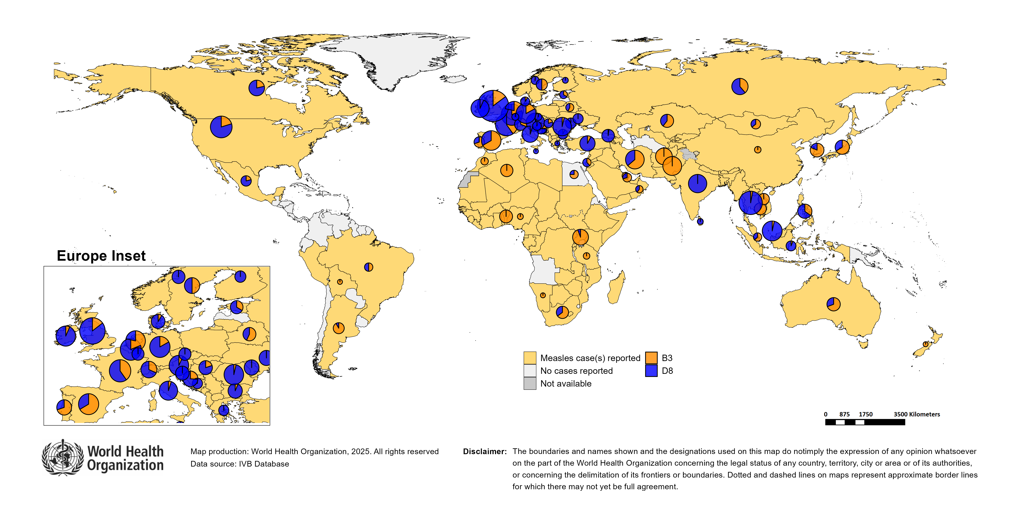
Distribution of measles genotypes (last 12 months)
Data Source: MeaNS2 database (Genotypes) and IVB Database (Incidence) as of 2025-06-10 and covering the period between 2024-05 and 2025-04 - Pie charts proportional to the number of sequenced viruses

Slide 45
Rubella

Slide 46
Number of reported rubella cases by WHO Region
2025
Region | Member States* | Rubella cases | Clin | Epi | Lab | Date Received
AFR | 38/47 | 1,098 | 0 | 0 | 1,098 | 2025-06
AMR | 24/35 | 0 | 0 | 0 | 0 | 2025-06
EMR | 20/21 | 441 | 231 | 4 | 206 | 2025-06
EUR | 28/53 | 315 | 13 | 7 | 295 | 2025-06
SEAR | 11/11 | 1,170 | 0 | 20 | 1,150 | 2025-06
WPR | 13/27 | 259 | 62 | 0 | 197 | 2025-06
Total | 134/194 | 3,283 | 306 | 31 | 2,946
Region | Jan | Feb | Mar | Apr | May | Jun | Jul | Aug | Sep | Oct | Nov | Dec
AFR | 241 | 304 | 304 | 214 | 35 | 0 | 0 | 0 | 0 | 0 | 0 | 0
AMR | 0 | 0 | 0 | 0 | 0 | 0 | 0 | 0 | 0 | 0 | 0 | 0
EMR | 121 | 142 | 103 | 63 | 12 | 0 | 0 | 0 | 0 | 0 | 0 | 0
EUR | 111 | 78 | 72 | 50 | 4 | 0 | 0 | 0 | 0 | 0 | 0 | 0
SEAR | 327 | 309 | 267 | 247 | 20 | 0 | 0 | 0 | 0 | 0 | 0 | 0
WPR | 47 | 68 | 71 | 73 | 0 | 0 | 0 | 0 | 0 | 0 | 0 | 0
Total | 847 | 901 | 817 | 647 | 71 | 0 | 0 | 0 | 0 | 0 | 0 | 0
2024
Region | Member States* | Rubella cases | Clin | Epi | Lab | Date Received
AFR | 43/47 | 15,738 | 0 | 0 | 15,738 | 2025-06
AMR | 28/35 | 0 | 0 | 0 | 0 | 2025-06
EMR | 20/21 | 3,484 | 2,516 | 188 | 780 | 2025-06
EUR | 33/53 | 511 | 213 | 2 | 296 | 2025-06
SEAR | 11/11 | 3,178 | 0 | 106 | 3,072 | 2025-06
WPR | 16/27 | 661 | 81 | 0 | 580 | 2025-06
Total | 151/194 | 23,572 | 2,810 | 296 | 20,466
Region | Jan | Feb | Mar | Apr | May | Jun | Jul | Aug | Sep | Oct | Nov | Dec
AFR | 357 | 345 | 645 | 567 | 832 | 574 | 396 | 1,897 | 4,278 | 3,063 | 1,880 | 904
AMR | 0 | 0 | 0 | 0 | 0 | 0 | 0 | 0 | 0 | 0 | 0 | 0
EMR | 335 | 361 | 365 | 288 | 351 | 285 | 235 | 264 | 376 | 358 | 188 | 78
EUR | 25 | 39 | 50 | 67 | 78 | 52 | 43 | 50 | 31 | 25 | 28 | 23
SEAR | 278 | 310 | 322 | 268 | 265 | 221 | 256 | 218 | 246 | 295 | 274 | 225
WPR | 44 | 33 | 75 | 68 | 63 | 44 | 47 | 64 | 45 | 70 | 50 | 58
Total | 1,039 | 1,088 | 1,457 | 1,258 | 1,589 | 1,176 | 977 | 2,493 | 4,976 | 3,811 | 2,420 | 1,288
Notes: Based on data received 2025-06 - This is surveillance data, hence for the last month, the data may be incomplete. * Member States Reporting / Total Member States in Region

Slide 47
Rubella case distribution by month and WHO Region (2017-2025)
2017
2018
2019
2020
2021
2022
2023
2024
2025
10,712 cases
17,045 cases
47,766 cases
7,501 cases
7,410 cases
12,620 cases
10,421 cases
23,572 cases
3,286 cases
9,000
AFR
AMR
6,000
EMR
EUR
SEAR
WPR
3,000
0
May
Sep
Sep
Sep
Sep
Sep
Sep
Sep
Sep
Sep
Apr
Aug
May
Aug
May
Aug
May
Aug
May
Aug
May
Aug
May
Aug
May
Aug
May
Aug
Jan
Jun
Jul
Oct
Jan
Apr
Jun
Jul
Oct
Jan
Apr
Jun
Jul
Oct
Jan
Apr
Jun
Jul
Oct
Jan
Apr
Jun
Jul
Oct
Jan
Apr
Jun
Jul
Oct
Jan
Apr
Jun
Jul
Oct
Jan
Apr
Jun
Jul
Oct
Jan
Apr
Jun
Jul
Oct
Feb
Mar
Nov
Dec
Feb
Mar
Nov
Dec
Feb
Mar
Nov
Dec
Feb
Mar
Nov
Dec
Feb
Mar
Nov
Dec
Feb
Mar
Nov
Dec
Feb
Mar
Nov
Dec
Feb
Mar
Nov
Dec
Feb
Mar
Nov
Dec
Based on data received 2025-06 - Data Source: IVB Database - This is surveillance data, hence for the last month(s), the data may be incomplete.

Slide 48
Rubella case distribution by month and WHO Region (2023-2025)
2023
2024
2025
10,421 cases
23,572 cases
3,286 cases
5,000
4,000
AFR
3,000
EMR
EUR
SEAR
2,000
WPR
1,000
0
Jan
Feb
Mar
Apr
May
Jun
Jul
Aug
Sep
Oct
Nov
Dec
Jan
Feb
Mar
Apr
May
Jun
Jul
Aug
Sep
Oct
Nov
Dec
Jan
Feb
Mar
Apr
May
Jun
Jul
Aug
Sep
Oct
Nov
Dec
Based on data received 2025-06 - Data Source: IVB Database - This is surveillance data, hence for the last month(s), the data may be incomplete.

Slide 49
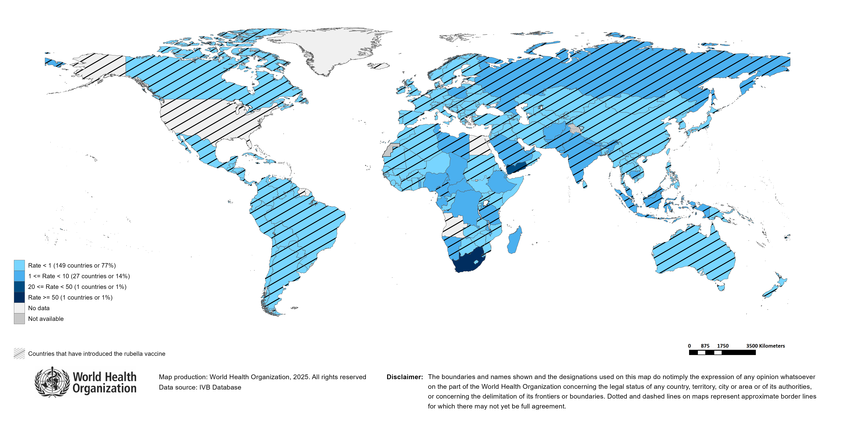
Rubella Incidence Rate per Million (12M period)
Highest incidence rates | Highest incidence rates | Highest incidence rates
Country | Cases | Rate
South Africa | 12794 | 199.88
Yemen | 1940 | 47.80
Gabon | 23 | 9.06
Chad | 157 | 7.73
Central African Republic | 21 | 3.94
United Republic of Tanzania | 262 | 3.82
Russian Federation | 484 | 3.34
Libya | 24 | 3.25
Eswatini | 4 | 3.22
Madagascar | 100 | 3.13
Notes: Based on data received 2025-06 - Surveillance data from 2024-11 to 2025-04 - Incidence: Number of cases / population * 1,000,000 - Population data: World population prospects, 2019 revision

Slide 50
Disclaimer
This document contains data provided to WHO by member states. Note that some member states only provide aggregate data to WHO, and for these, we are unable to generate a country profile. Some member states report all cases at one time point for the entire year, and thus epidemiologic curves generated are not accurate and a reporting artifact. For some countries, cases are reported by age category, not by exact age in months and/or years. Thus, age distribution/incidence is approximate. Cases classified as pending by countries are classified at WHO as clinically compatible at this time, and thus numbers might different between data shown here and provided by the member state or WHO country/regional offices.
*UN population data is used as the denominator for calculating incidence.

Slide 51
Rubella cases (AFR)
AFR Rubella Case Distribution (January 2023-June 2025)
Top 10 countries (last 12 M) | Top 10 countries (last 12 M) | Top 10 countries (last 12 M) | Top 10 countries (last 12 M)
Country | RCV in RI | Cases | % of Total
South Africa | No | 12130 | 86
Nigeria | No | 489 | 3
Ethiopia | No | 329 | 2
DR Congo | No | 319 | 2
Others | - | 242 | 2
United Republic of Tanzania | 2014 | 232 | 2
Chad | No | 136 | 1
Madagascar | No | 94 | 1
Malawi | 2017 | 47 | 0
Uganda | 2019 | 43 | 0
Cameroon | 2015 | 29 | 0
2023
2024
2025
4,000
3,000
(lab + epi-linked + clinical)
Number of cases
2,000
1,000
0
Jan
Feb
Mar
Apr
May
Jun
Jul
Aug
Sep
Oct
Nov
Dec
Jan
Feb
Mar
Apr
May
Jun
Jul
Aug
Sep
Oct
Nov
Dec
Jan
Feb
Mar
Apr
May
Jun
Jul
Aug
Sep
Oct
Nov
Dec
Introduced less than 5 years ago
Introduced more than 5 years ago
Not introduced in EPI
(after 2020)
(2020 and before)
AFR Age distribution of Rubella IgM+ cases by vaccine introduction status in the National EPI Programme (last 12 Months)
1500
1000
(IgM+ only)
Number of cases
500
0
0
10
20
30
40
Age at onset (in years)
Rubella vaccine introduced before 1 January 2025
Rubella vaccine not introduced before 1 January 2025
Notes: Based on data received 2025-06 Data Source: IVB Database.

Slide 52
Rubella cases: Congo
ELIMINATION STATUS:
ENDEMIC
2022
2023
2024
2025
Total = 1 cases
Total = 5 cases
Total = 4 cases
Total = 1 cases
2
Rubella cases
1
0
Jan
Feb
Mar
Apr
May
Jun
Jul
Aug
Sep
Oct
Nov
Dec
Jan
Feb
Mar
Apr
May
Jun
Jul
Aug
Sep
Oct
Nov
Dec
Jan
Feb
Mar
Apr
May
Jun
Jul
Aug
Sep
Oct
Nov
Dec
Jan
Feb
Mar
Apr
May
Jun
Jul
Aug
Sep
Oct
Nov
Dec
Clinical
Epi
Lab
Age distribution, sex and incidence (Last 12 months)
WHO/UNICEF Coverage Estimates (WUENIC)
1.00
6
100
0.75
4
80
0.50
Incidence rate per M
60
Number of cases
2
% Coverage
0.25
40
0.00
0
20
<1 yr
1-4 yrs
5-9 yrs
10-14 yrs
15-24 yrs
25-39 yrs
40+ yrs
0
Age at onset (in years)
2000
2001
2002
2003
2004
2005
2006
2007
2008
2009
2010
2011
2012
2013
2014
2015
2016
2017
2018
2019
2020
2021
2022
2023
Incidence
Male
Female
Unknown
RCV1

Slide 53
Rubella cases: Democratic Republic of the Congo
ELIMINATION STATUS:
ENDEMIC
2022
2023
2024
2025
Total = 1,237 cases
Total = 594 cases
Total = 300 cases
Total = 146 cases
200
Rubella cases
100
0
Jan
Feb
Mar
Apr
May
Jun
Jul
Aug
Sep
Oct
Nov
Dec
Jan
Feb
Mar
Apr
May
Jun
Jul
Aug
Sep
Oct
Nov
Dec
Jan
Feb
Mar
Apr
May
Jun
Jul
Aug
Sep
Oct
Nov
Dec
Jan
Feb
Mar
Apr
May
Jun
Jul
Aug
Sep
Oct
Nov
Dec
Clinical
Epi
Lab
Age distribution, sex and incidence (Last 12 months)
WHO/UNICEF Coverage Estimates (WUENIC)
100
100
7.5
80
5.0
Number of cases
Incidence rate per M
60
50
2.5
% Coverage
40
0
0.0
20
<1 yr
1-4 yrs
5-9 yrs
10-14 yrs
15-24 yrs
25-39 yrs
40+ yrs
0
Age at onset (in years)
2000
2001
2002
2003
2004
2005
2006
2007
2008
2009
2010
2011
2012
2013
2014
2015
2016
2017
2018
2019
2020
2021
2022
2023
Incidence
Male
Female
Unknown
RCV1

Slide 54
Rubella cases (EMR)
EMR Rubella Case Distribution (January 2023-June 2025)
Top 10 countries (last 12 M) | Top 10 countries (last 12 M) | Top 10 countries (last 12 M) | Top 10 countries (last 12 M)
Country | RCV in RI | Cases | % of Total
Yemen | 2015 | 1685 | 76
Pakistan | 2022 | 212 | 10
Afghanistan | No | 104 | 5
Saudi Arabia | 1982 | 48 | 2
Sudan | 2024 | 42 | 2
Others | - | 29 | 1
Libya | 1993 | 24 | 1
Iran (Islamic Republic of) | 2004 | 18 | 1
Syrian Arab Republic | 1999 | 17 | 1
Tunisia | 2012 | 17 | 1
Iraq | 1989 | 12 | 1
2023
2024
2025
300
200
(lab + epi-linked + clinical)
Number of cases
100
0
Jan
Feb
Mar
Apr
May
Jun
Jul
Aug
Sep
Oct
Nov
Dec
Jan
Feb
Mar
Apr
May
Jun
Jul
Aug
Sep
Oct
Nov
Dec
Jan
Feb
Mar
Apr
May
Jun
Jul
Aug
Sep
Oct
Nov
Dec
Introduced less than 5 years ago
Introduced more than 5 years ago
Not introduced in EPI
(after 2020)
(2020 and before)
EMR Age distribution of Rubella IgM+ cases by vaccine introduction status in the National EPI Programme (last 12 Months)
400
300
(IgM+ only)
Number of cases
200
100
0
0
10
20
30
40
Age at onset (in years)
Rubella vaccine introduced before 1 January 2025
Rubella vaccine not introduced before 1 January 2025
Notes: Based on data received 2025-06 Data Source: IVB Database.

Slide 55
Rubella cases (EUR)
EUR Rubella Case Distribution (January 2023-June 2025)
Top 10 countries (last 12 M) | Top 10 countries (last 12 M) | Top 10 countries (last 12 M) | Top 10 countries (last 12 M)
Country | RCV in RI | Cases | % of Total
Russian Federation | 2000 | 445 | 78
Poland | 1988 | 74 | 13
Türkiye | 2006 | 14 | 2
Ukraine | 2003 | 9 | 2
Germany | 1991 | 8 | 1
Kyrgyzstan | 2001 | 4 | 1
Sweden | 1982 | 4 | 1
Others | - | 3 | 1
Uzbekistan | 2006 | 3 | 1
Kazakhstan | 2004 | 2 | 0
Bulgaria | 1992 | 1 | 0
2023
2024
2025
90
60
(lab + epi-linked + clinical)
Number of cases
30
0
Jan
Feb
Mar
Apr
May
Jun
Jul
Aug
Sep
Oct
Nov
Dec
Jan
Feb
Mar
Apr
May
Jun
Jul
Aug
Sep
Oct
Nov
Dec
Jan
Feb
Mar
Apr
May
Jun
Jul
Aug
Sep
Oct
Nov
Dec
Introduced more than 5 years ago
(2020 and before)
EUR Age distribution of Rubella IgM+ cases by vaccine introduction status in the National EPI Programme (last 12 Months)
20
15
(IgM+ only)
Number of cases
10
5
0
0
10
20
30
40
Age at onset (in years)
Rubella vaccine introduced before 1 January 2025
Rubella vaccine not introduced before 1 January 2025
Notes: Based on data received 2025-06 Data Source: IVB Database. Spikes in age-distribution curve are an artifact of reporting by age bands ( 0=<1 yrs, 2=1-4 yrs, 7=5-9 yrs, 12=10-14 yrs, 17=15-19 yrs, 25=20-29 yrs, 45=30+yrs) instead of by age from some member states.

Slide 56
Rubella cases (SEAR (excl. India))
SEAR (excl. India) Rubella Case Distribution (January 2023-June 2025)
Top 10 countries (last 12 M) | Top 10 countries (last 12 M) | Top 10 countries (last 12 M) | Top 10 countries (last 12 M)
Country | RCV in RI | Cases | % of Total
Indonesia | 2018 | 382 | 68
Bangladesh | 2012 | 83 | 15
Nepal | 2013 | 68 | 12
Thailand | 1997 | 25 | 4
Myanmar | 2015 | 5 | 1
2023
2024
2025
125
100
75
(lab + epi-linked + clinical)
Number of cases
50
25
0
Jan
Feb
Mar
Apr
May
Jun
Jul
Aug
Sep
Oct
Nov
Dec
Jan
Feb
Mar
Apr
May
Jun
Jul
Aug
Sep
Oct
Nov
Dec
Jan
Feb
Mar
Apr
May
Jun
Jul
Aug
Sep
Oct
Nov
Dec
Introduced more than 5 years ago
(2020 and before)
SEAR (excl. India) Age distribution of Rubella IgM+ cases by vaccine introduction status in the National EPI Programme (last 12 Months)
75
50
(IgM+ only)
Number of cases
25
0
0
10
20
30
40
Age at onset (in years)
Rubella vaccine introduced before 1 January 2025
Rubella vaccine not introduced before 1 January 2025
Notes: Based on data received 2025-06 Data Source: IVB Database.

Slide 57
Rubella cases: Indonesia
ELIMINATION STATUS:
ENDEMIC
2022
2023
2024
2025
150
Total = 755 cases
Total = 477 cases
Total = 457 cases
Total = 136 cases
100
Rubella cases
50
0
Jan
Feb
Mar
Apr
May
Jun
Jul
Aug
Sep
Oct
Nov
Dec
Jan
Feb
Mar
Apr
May
Jun
Jul
Aug
Sep
Oct
Nov
Dec
Jan
Feb
Mar
Apr
May
Jun
Jul
Aug
Sep
Oct
Nov
Dec
Jan
Feb
Mar
Apr
May
Jun
Jul
Aug
Sep
Oct
Nov
Dec
Clinical
Epi
Lab
Age distribution, sex and incidence (Last 12 months)
WHO/UNICEF Coverage Estimates (WUENIC)
3
0.8
100
2
0.6
80
0.4
Number of cases
Incidence rate per M
60
1
0.2
% Coverage
40
0
0.0
20
<1 yr
1-4 yrs
5-9 yrs
10-14 yrs
15-24 yrs
25-39 yrs
40+ yrs
0
Age at onset (in years)
2000
2001
2002
2003
2004
2005
2006
2007
2008
2009
2010
2011
2012
2013
2014
2015
2016
2017
2018
2019
2020
2021
2022
2023
Incidence
Male
Female
Unknown
RCV1

Slide 58
Rubella cases (SEAR, India)
SEAR, India Rubella Case Distribution (January 2023-June 2025)
Top 10 countries (last 12 M) | Top 10 countries (last 12 M) | Top 10 countries (last 12 M) | Top 10 countries (last 12 M)
Country | RCV in RI | Cases | % of Total
India | 2018 | 2342 | 100
2023
2024
2025
300
200
(lab + epi-linked + clinical)
Number of cases
100
0
Jan
Feb
Mar
Apr
May
Jun
Jul
Aug
Sep
Oct
Nov
Dec
Jan
Feb
Mar
Apr
May
Jun
Jul
Aug
Sep
Oct
Nov
Dec
Jan
Feb
Mar
Apr
May
Jun
Jul
Aug
Sep
Oct
Nov
Dec
Introduced more than 5 years ago
(2020 and before)
SEAR, India Age distribution of Rubella IgM+ cases by vaccine introduction status in the National EPI Programme (last 12 Months)
600
400
(IgM+ only)
Number of cases
200
0
0
10
20
30
40
Age at onset (in years)
Rubella vaccine introduced before 1 January 2025
Rubella vaccine not introduced before 1 January 2025
Notes: Based on data received 2025-06 Data Source: IVB Database.

Slide 59
Rubella cases: India
ELIMINATION STATUS:
ENDEMIC
2022
2023
2024
2025
500
Total = 2,559 cases
Total = 2,930 cases
Total = 2,523 cases
Total = 984 cases
400
300
Rubella cases
200
100
0
Jan
Feb
Mar
Apr
May
Jun
Jul
Aug
Sep
Oct
Nov
Dec
Jan
Feb
Mar
Apr
May
Jun
Jul
Aug
Sep
Oct
Nov
Dec
Jan
Feb
Mar
Apr
May
Jun
Jul
Aug
Sep
Oct
Nov
Dec
Jan
Feb
Mar
Apr
May
Jun
Jul
Aug
Sep
Oct
Nov
Dec
Clinical
Epi
Lab
Age distribution, sex and incidence (Last 12 months)
WHO/UNICEF Coverage Estimates (WUENIC)
30
100
750
80
500
20
Number of cases
Incidence rate per M
60
250
10
% Coverage
40
0
0
20
<1 yr
1-4 yrs
5-9 yrs
10-14 yrs
15-24 yrs
25-39 yrs
40+ yrs
0
Age at onset (in years)
2000
2001
2002
2003
2004
2005
2006
2007
2008
2009
2010
2011
2012
2013
2014
2015
2016
2017
2018
2019
2020
2021
2022
2023
Incidence
Male
Female
Unknown
RCV1

Slide 60
Rubella cases (WPR)
WPR Rubella Case Distribution (January 2023-June 2025)
Top 10 countries (last 12 M) | Top 10 countries (last 12 M) | Top 10 countries (last 12 M) | Top 10 countries (last 12 M)
Country | RCV in RI | Cases | % of Total
China | 2008 | 440 | 69
Malaysia | 2004 | 86 | 14
Cambodia | 2013 | 42 | 7
Philippines | 2010 | 41 | 6
Viet Nam | 2015 | 15 | 2
Japan | 1995 | 12 | 2
Singapore | 1982 | 1 | 0
2023
2024
2025
75
50
(lab + epi-linked + clinical)
Number of cases
25
0
Jan
Feb
Mar
Apr
May
Jun
Jul
Aug
Sep
Oct
Nov
Dec
Jan
Feb
Mar
Apr
May
Jun
Jul
Aug
Sep
Oct
Nov
Dec
Jan
Feb
Mar
Apr
May
Jun
Jul
Aug
Sep
Oct
Nov
Dec
Introduced more than 5 years ago
(2020 and before)
WPR Age distribution of Rubella IgM+ cases by vaccine introduction status in the National EPI Programme (last 12 Months)
100
75
50
(IgM+ only)
Number of cases
25
0
0
10
20
30
40
Age at onset (in years)
Rubella vaccine introduced before 1 January 2025
Rubella vaccine not introduced before 1 January 2025
Notes: Based on data received 2025-06 Data Source: IVB Database.

Slide 61
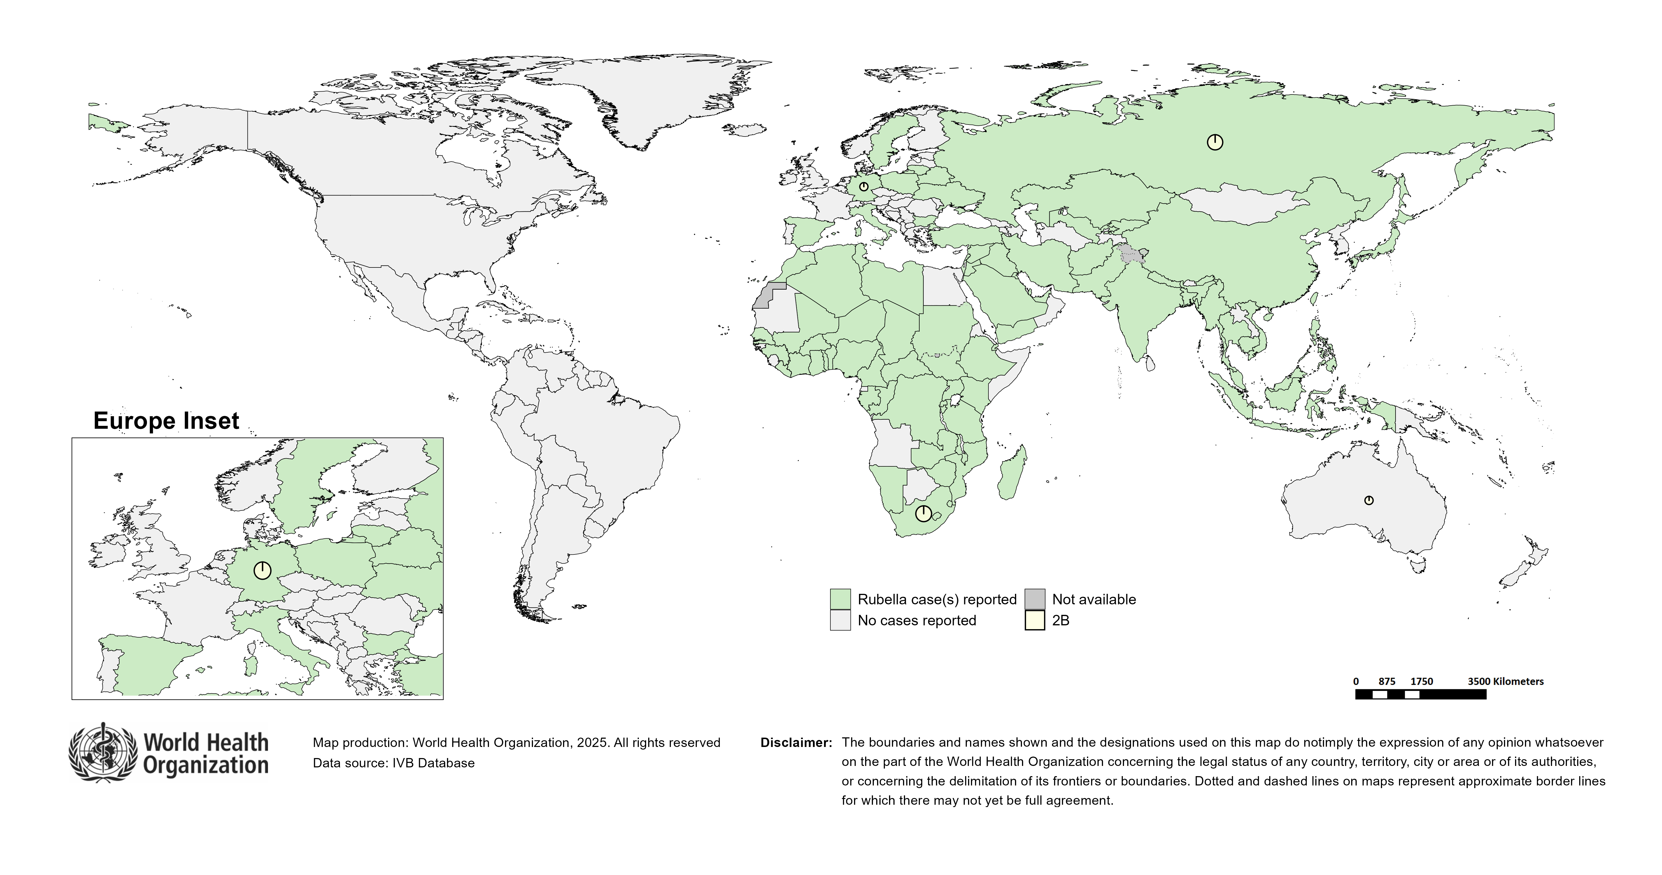
Distribution of rubella genotypes (last 12 months)
Data Source: RUBENS2 database (Genotypes) and IVB Database (Incidence) as of 2025-06-10 and covering the period between 2024-05 and 2025-04 - Pie charts proportional to the number of sequenced viruses

Slide 62
Laboratory

Slide 63
Measles and Rubella IgM Data Summary
2025
Region | Member States* | Specimens received | Measles tested | Measles positive n(%) | Measles equivocal n(%) | Measles negative n(%) | Rubella tested | Rubella positive n(%) | Rubella equivocal n(%) | Rubella negative n(%)
AFR | 37/47 | 14,998 | 14,324 | 3,871 (27) | 228 (2) | 8,329 (58) | 10,058 | 779 (8) | 124 (1) | 7,251 (72)
AMR | 24/35 | 5,467 | 5,559 | 922 (17) | 164 (3) | 4,473 (80) | 5,444 | 120 (2) | 57 (1) | 5,267 (97)
EMR | 20/21 | 38,910 | 28,577 | 13,603 (48) | 15 (0) | 14,959 (52) | 22,631 | 372 (2) | 16 (0) | 22,243 (98)
EUR | 38/53 | 12,160 | 10,147 | 4,385 (43) | 100 (1) | 5,820 (57) | 4,532 | 213 (5) | 85 (2) | 4,025 (89)
SEAR | 11/11 | 38,810 | 36,402 | 4,673 (13) | 589 (2) | 31,141 (86) | 34,560 | 1,043 (3) | 287 (1) | 33,219 (96)
WPR | 25/27 | 9,131 | 8,671 | 2,778 (32) | 166 (2) | 5,712 (66) | 7,615 | 241 (3) | 37 (0) | 7,335 (96)
Total | 155/194 | 119,476 | 103,680 | 30,232 (29) | 1,262 (1) | 70,434 (68) | 84,840 | 2,768 (3) | 606 (1) | 79,340 (94)
2024
Region | Member States* | Specimens received | Measles tested | Measles positive n(%) | Measles equivocal n(%) | Measles negative n(%) | Rubella tested | Rubella positive n(%) | Rubella equivocal n(%) | Rubella negative n(%)
AFR | 43/47 | 120,445 | 109,377 | 19,102 (17) | 1,068 (1) | 61,018 (56) | 95,315 | 14,882 (16) | 465 (0) | 51,744 (54)
AMR | 29/35 | 7,997 | 8,446 | 361 (4) | 206 (2) | 7,879 (93) | 7,682 | 179 (2) | 103 (1) | 7,400 (96)
EMR | 20/21 | 113,653 | 95,260 | 38,161 (40) | 126 (0) | 56,973 (60) | 87,045 | 1,407 (2) | 76 (0) | 85,562 (98)
EUR | 44/53 | 159,496 | 137,242 | 78,299 (57) | 404 (0) | 53,578 (39) | 56,088 | 1,305 (2) | 363 (1) | 54,154 (97)
SEAR | 11/11 | 129,727 | 127,549 | 18,898 (15) | 3,678 (3) | 108,724 (85) | 117,938 | 3,087 (3) | 3,040 (3) | 114,106 (97)
WPR | 25/27 | 23,799 | 22,032 | 5,695 (26) | 505 (2) | 15,807 (72) | 17,280 | 601 (3) | 88 (1) | 16,560 (96)
Total | 172/194 | 555,117 | 499,906 | 160,516 (32) | 5,987 (1) | 303,979 (61) | 381,348 | 21,461 (6) | 4,135 (1) | 329,526 (86)
Notes: Based on data received 2025-06 - * Member States Reporting / Total Member States in Region

Slide 64
Supplementary Immunization Activities

Slide 65
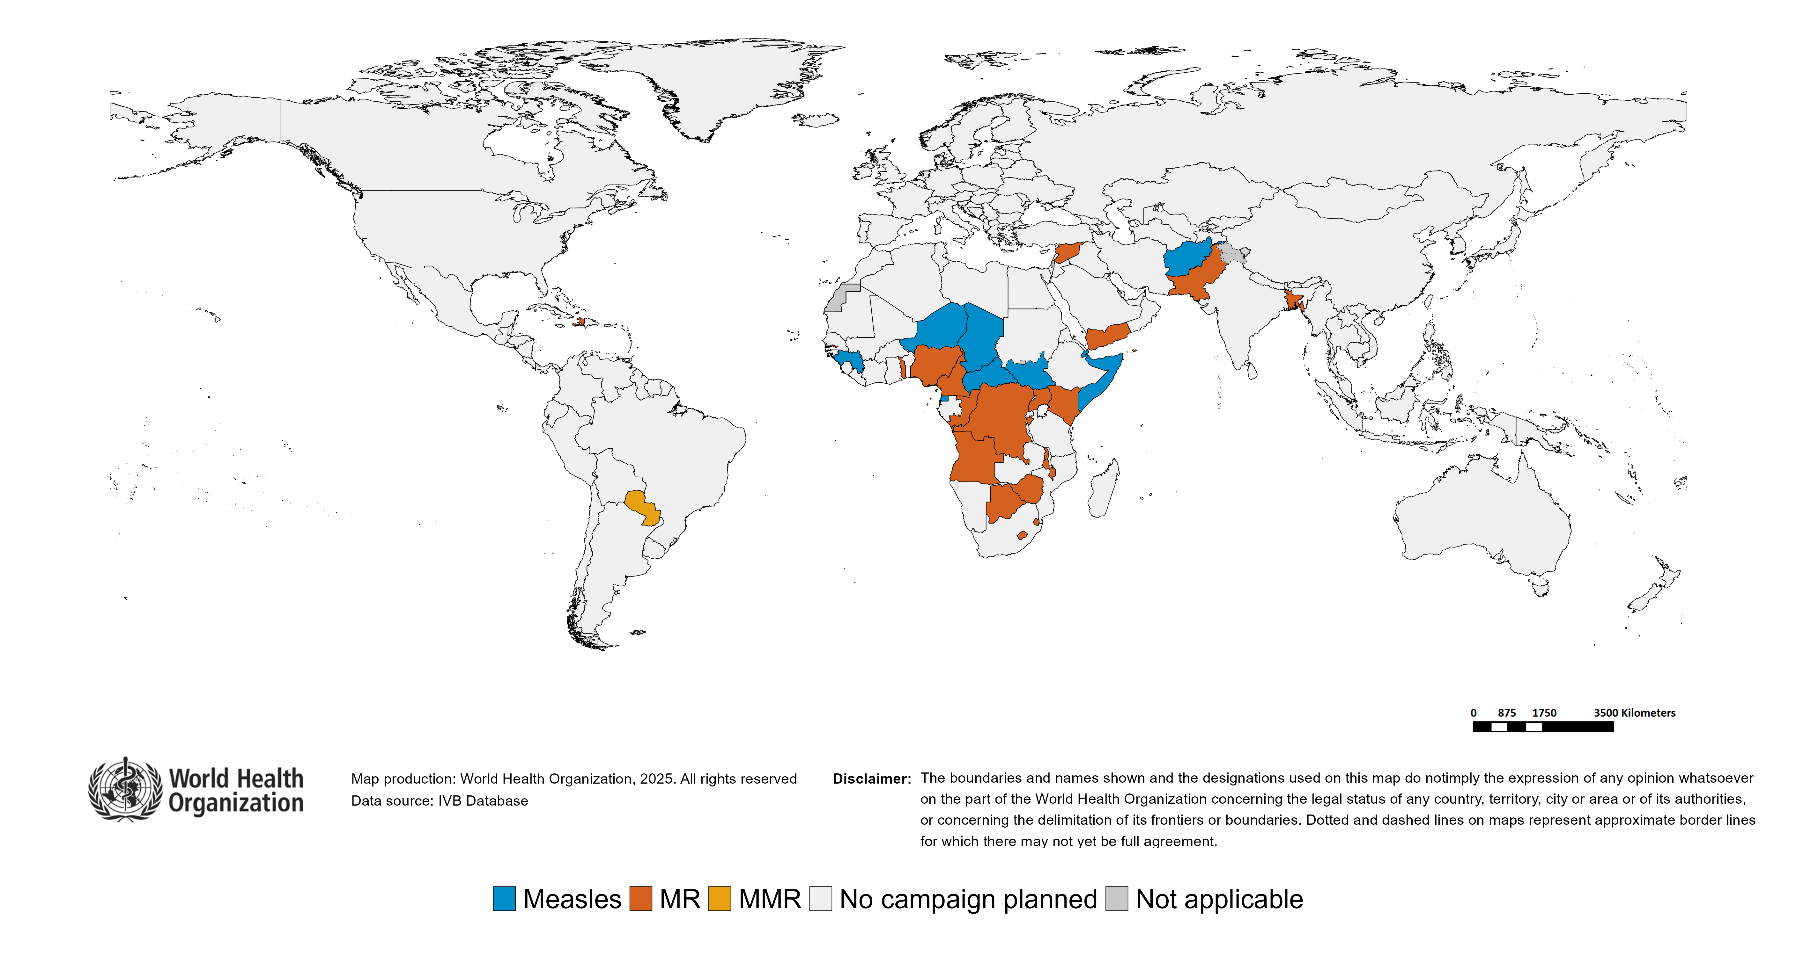
Upcoming MMR, MR and Measles campaigns (2025-2026)

Slide 66
Upcoming MMR, MR and Measles campaigns (2025-2026)
Year | Region | Name | Type | Intervention | StartDate | Status | Age Group(s) | Extent | Target
2025 | AFR | Guinea | SNID | MEASLES | 2025-02-?? | Planned | 0-59 M | SUBNATIONAL | 996214
2025 | AFR | Equatorial Guinea | FollowUp | MEASLES | 2025-04-?? | Planned | 9 M-10 Y | NATIONAL | 178451
2025 | AFR | Niger | FollowUp | MEASLES | 2025-04-?? | Planned | 9-59 M | NATIONAL | 5080313
2025 | AFR | Eswatini | FollowUp | MR | 2025-06-?? | Planned | 9-59 M | NATIONAL | 156297
2025 | AFR | Kenya | OR | MR | 2025-06-?? | Planned | 9-59 M | NATIONAL | 7124112
2025 | AFR | South Sudan | FollowUp | MEASLES | 2025-06-?? | Planned | 9-59 M | NATIONAL | 1485839
2025 | AFR | Zimbabwe | FollowUp | MR | 2025-07-?? | Planned | 9-59 M | NATIONAL | 2518935
2025 | AFR | Central African Republic | FollowUp | MEASLES | 2025-10-?? | Planned | 6-59 M | NATIONAL | 1335862
2025 | AFR | Congo | FollowUp | MR | 2025-10-?? | Planned | 9-59 M | NATIONAL | 927595
2025 | AFR | Democratic Republic of the Congo | CatchUp | MR | 2025-10-?? | Planned | 9 M-14 Y | NATIONAL | 61697195
2025 | AFR | Gambia | FollowUp | MR | 2025-10-?? | Planned | 9-59 M | NATIONAL | 385713
2025 | AFR | Nigeria | CatchUp-SIA | MR | 2025-10-?? | Planned | 9 M-14 Y | NATIONAL | 102539762
2025 | AFR | Lesotho | CatchUp-SIA | MR | 2025-10-22 | Planned | 9-59 M | NATIONAL | 188518
2025 | AFR | Botswana | FollowUp | MR | 2025-11-?? | Planned | 9-59 M | NATIONAL | 223959
2025 | AFR | Chad | FollowUp | MEASLES | 2025-11-?? | Planned | 9-59 M | NATIONAL | 3772072
2025 | AFR | Comoros | FollowUp | MR | 2025-11-?? | Planned | 6-59 M | NATIONAL | 101686
2025 | AFR | Togo | FollowUp | MR | 2025-11-?? | Planned | 9 M-9 Y | NATIONAL | 2201427
2025 | AFR | Uganda | FollowUp | MR | 2025-11-?? | Planned | 9-59 M | NATIONAL | 7685529
2025 | AFR | Comoros | FollowUp | MR | 2025-12-?? | Planned | 9-59 M | NATIONAL | 113688
2025 | AMR | Turks and Caicos Islands | VaccinationWeek | MMR | 2025-04-?? | Planned | 5-14 Y | NATIONAL | 100
2025 | EMR | Syrian Arab Republic | FollowUp | MR | 2025-10-?? | Planned | 9-59 M | NATIONAL | 1892447
2025 | EMR | Afghanistan | FollowUp | MEASLES | 2025-11-?? | Planned | 9-59 M | NATIONAL | 16047992
2025 | EMR | Pakistan | FollowUp | MR | 2025-11-?? | Planned | 9-59 M | NATIONAL | 29604478
2025 | EMR | Somalia | FollowUp | MEASLES | 2025-NA-?? | Planned | 9-59 M | NATIONAL | 3200130
2026 | AFR | Malawi | FollowUp | MR | 2026-04-?? | Planned | 9-59 M | NATIONAL | 5850406
2026 | AFR | Burundi | FollowUp | MR | 2026-10-?? | Planned | 9-59 M | NATIONAL | 2446535
2026 | AFR | Angola | FollowUp | MR | 2026-NA-?? | Planned | 9-59 M | NATIONAL | 5983408
2026 | AFR | Cameroon | FollowUp | MR | 2026-NA-?? | Planned | 9-59 M | NATIONAL | 4345819
2026 | AFR | Equatorial Guinea | FollowUp | MEASLES | 2026-NA-?? | Planned | 9-59 M | NATIONAL | 229691
2026 | AMR | Paraguay | Campaign | MMR | 2026-10-?? | Planned | 12-59 M | NATIONAL | 509698
2026 | AMR | Haiti | Campaign | MR | 2026-NA-?? | Planned | 9-59 M | NATIONAL | 1236480
2026 | EMR | Djibouti | CatchUp | MEASLES | 2026-NA-?? | Planned | 9-59 M | NATIONAL | 340185
2026 | EMR | Yemen | FollowUp | MR | 2026-NA-?? | Planned | 9-59 M | NATIONAL | 4714060
2026 | SEAR | Bangladesh | FollowUp | MR | 2026-01-?? | Planned | 9 M-14 Y | NATIONAL | 19808176

Slide 67
WHO Bulletins and Newsletters

